Slide 1

Presentation on Enumeration methodology of 7th Population & Housing Census
“ The Digital Census”

Slide 2


Slide 3
Listing
Detail Conceptual Training of Listing
  Concept and Definition of Structure
  Explanation of Residential, Economic and Mixed Structures.
  Difference Between Structure, Housing unit and Household.
  Units of structures (Household, Institutional Household, Economic Units both Commercial and Non Commercial)
  Videos (8 Videos)
  Case Study (4 Case Studies)
Household Economic Activities
Pakistan Standard Industrial Classifications (PSIC)

Slide 4
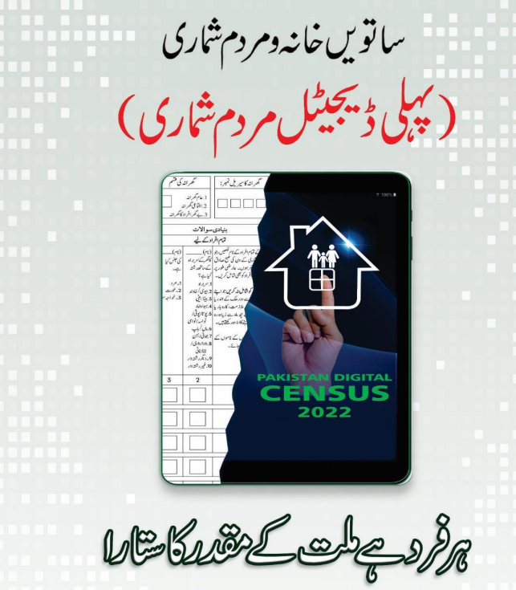

Slide 5

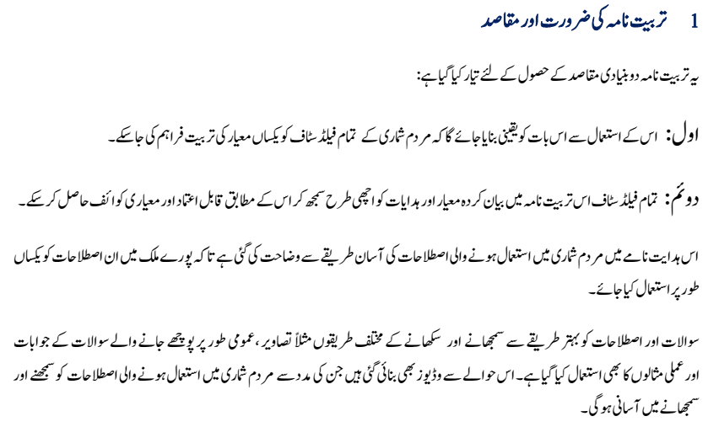

Slide 6
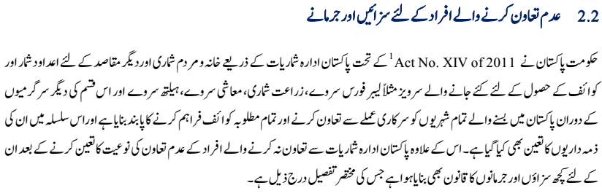

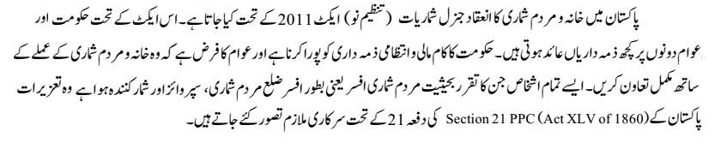
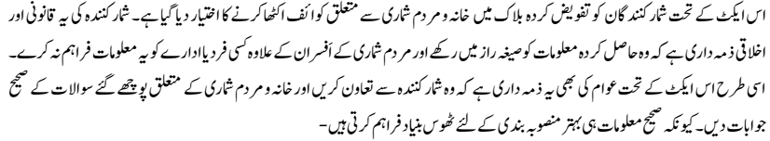
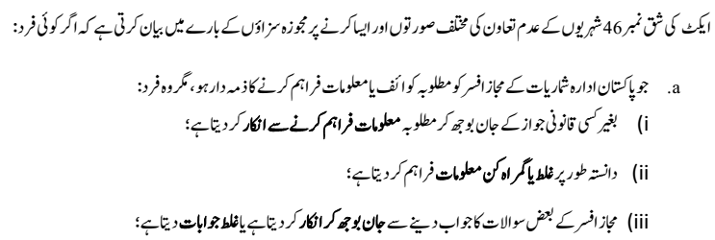

Slide 7

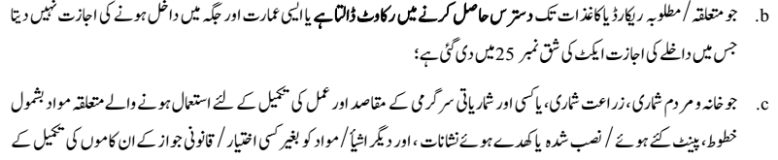
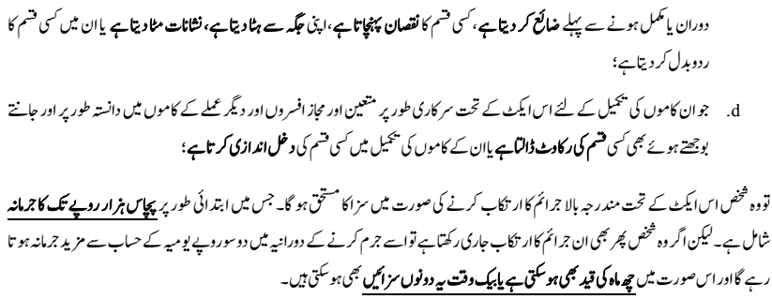

Slide 8

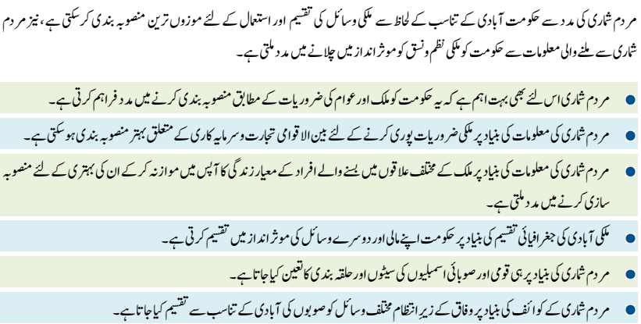

Slide 9

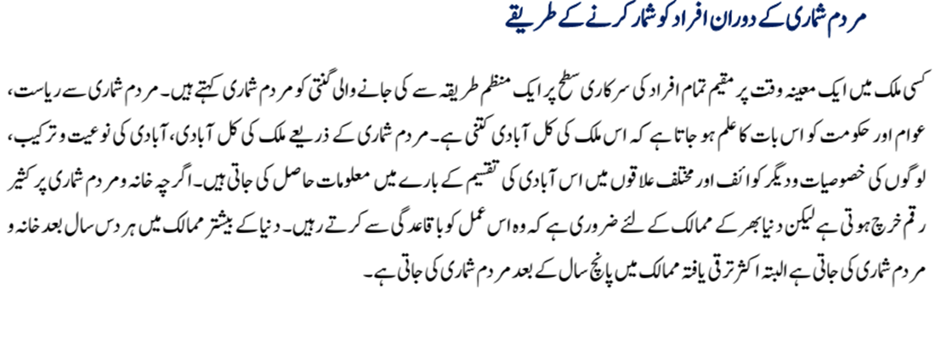

Slide 10

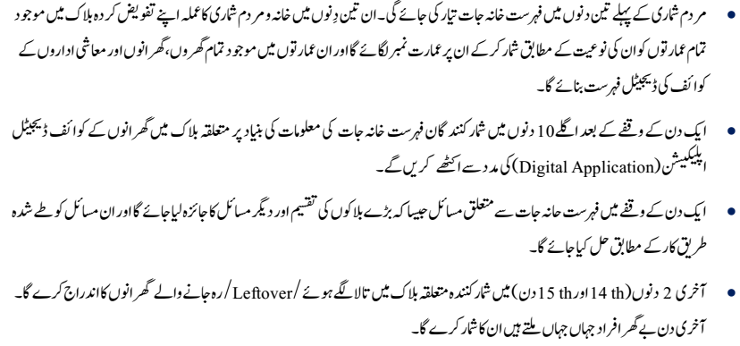
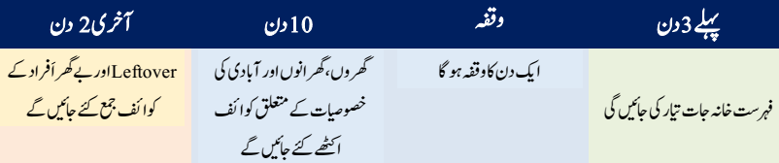

Slide 11
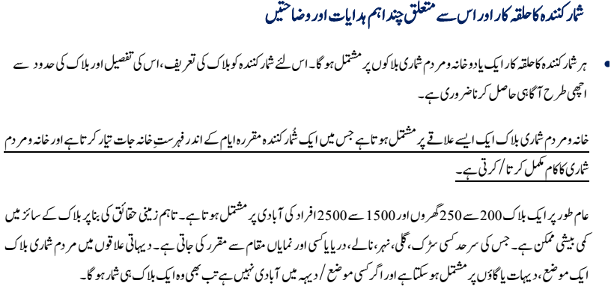
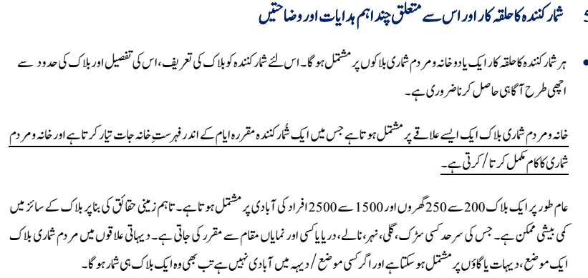
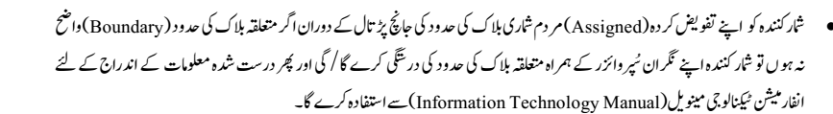

Slide 12

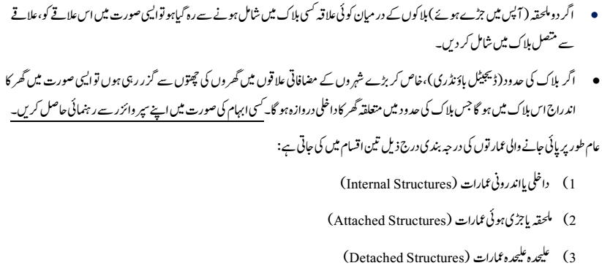

Slide 13
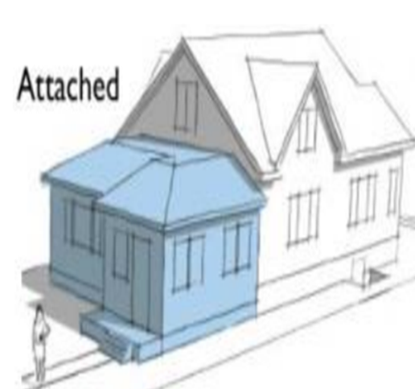
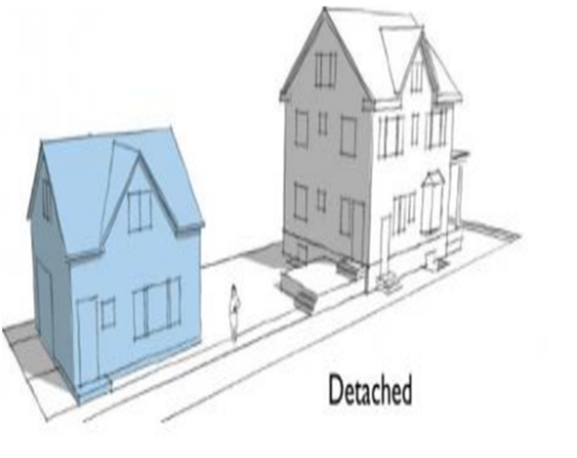

Slide 14
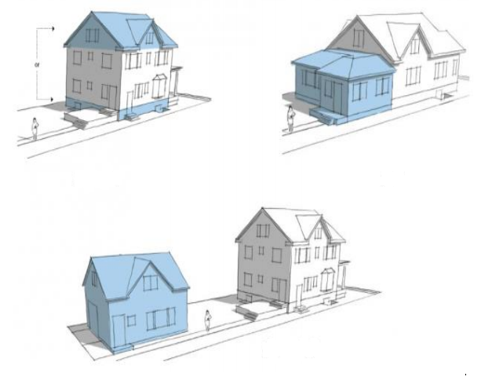

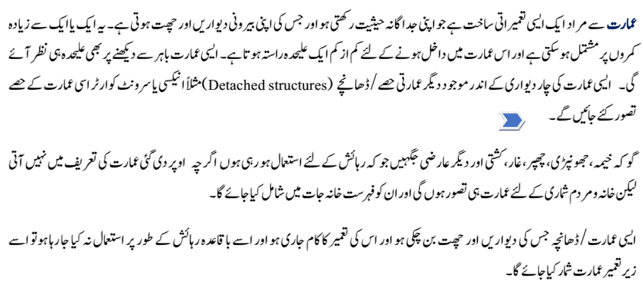

Slide 15

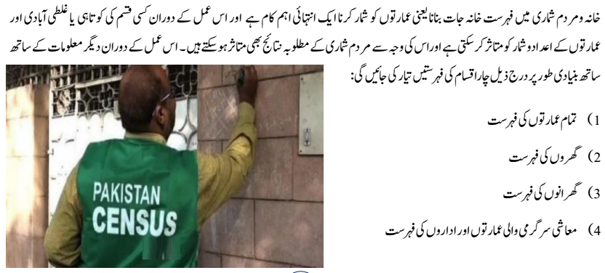

Slide 16

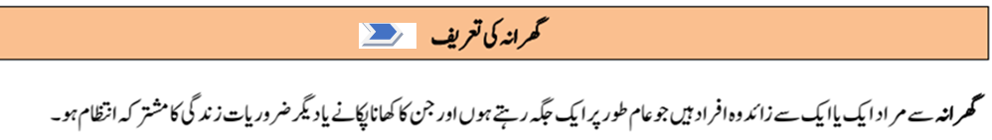
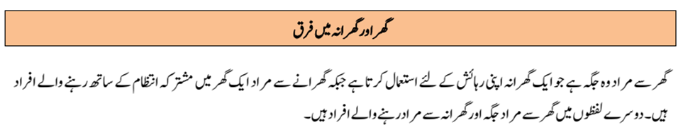
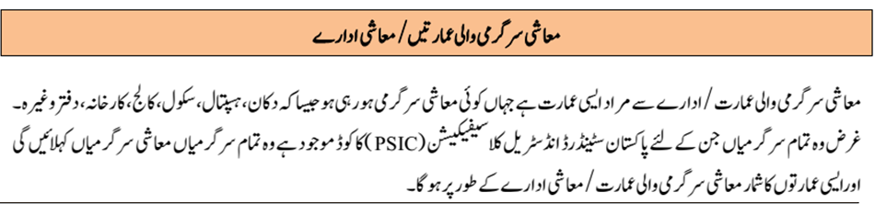

Slide 17
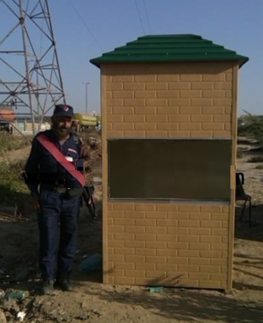



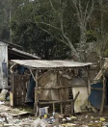
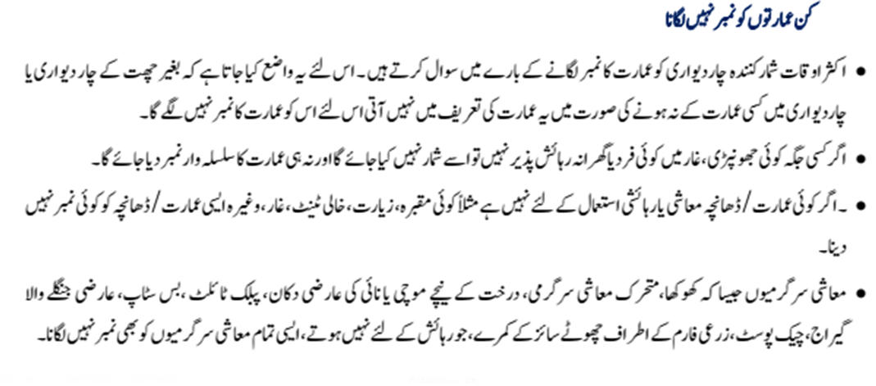

Slide 18


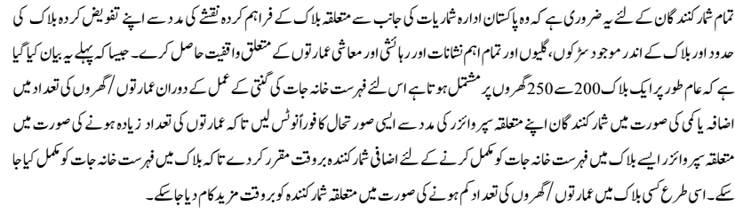

Slide 19
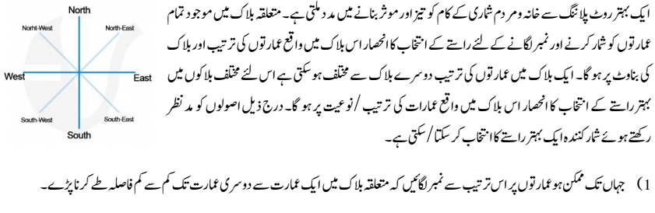
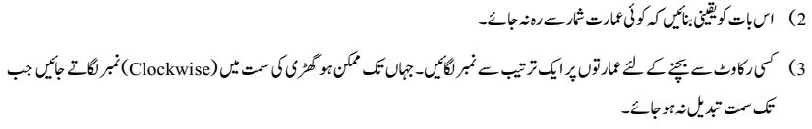

Slide 20
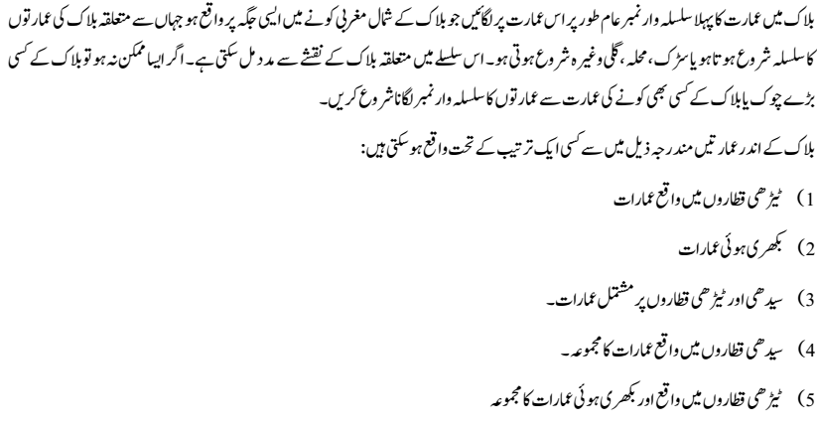

Slide 21
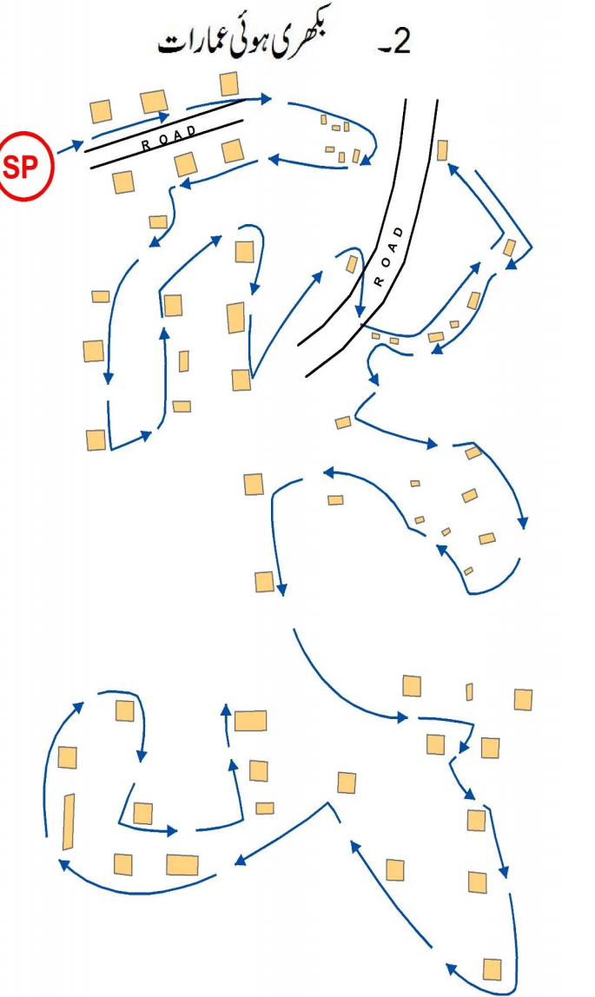
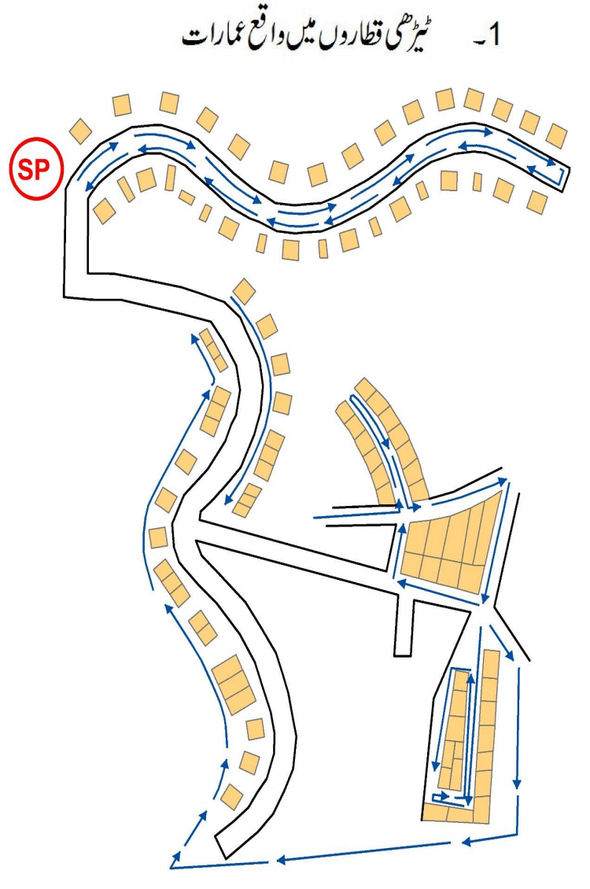

Slide 22

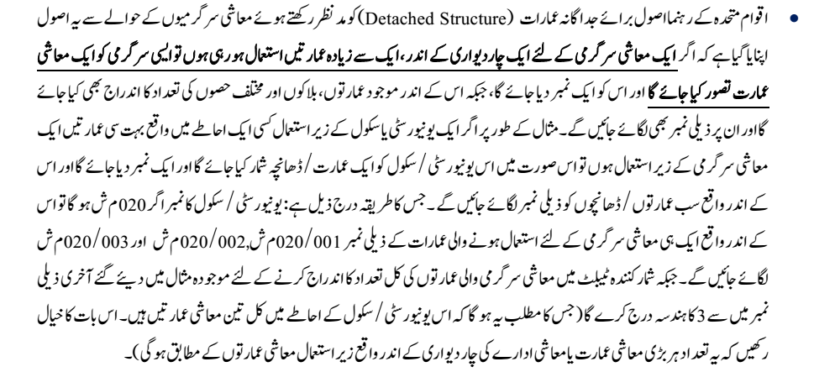
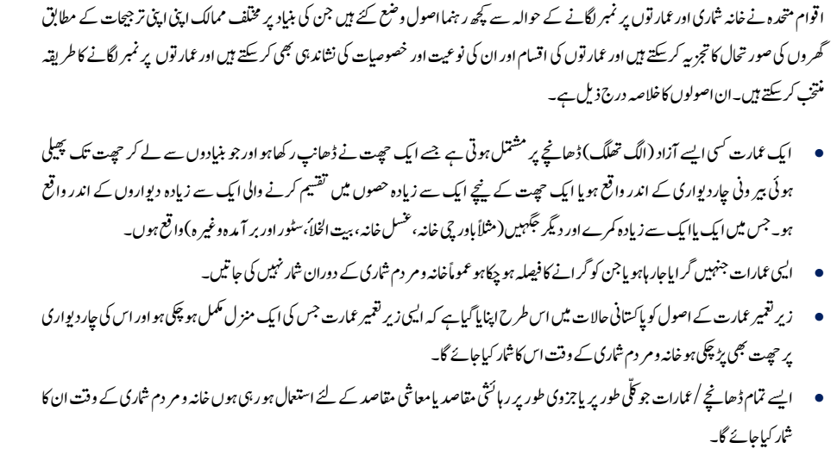

Slide 23
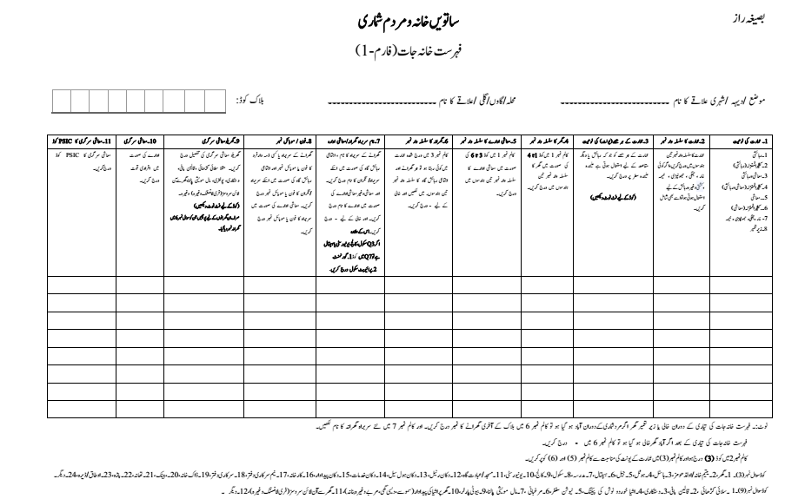

Slide 24
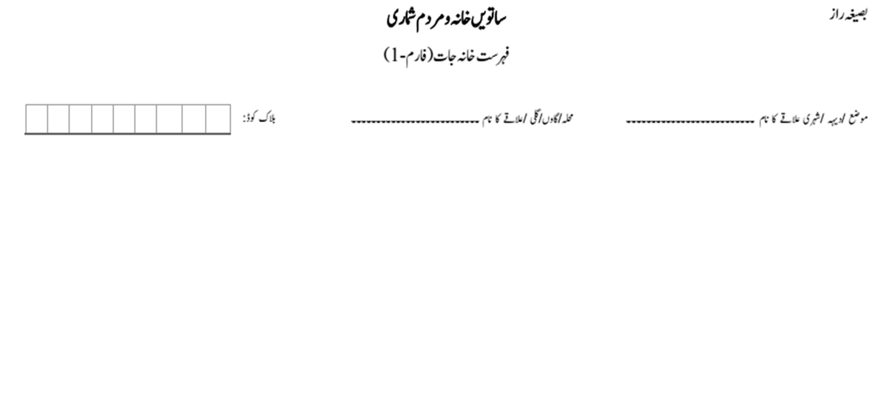
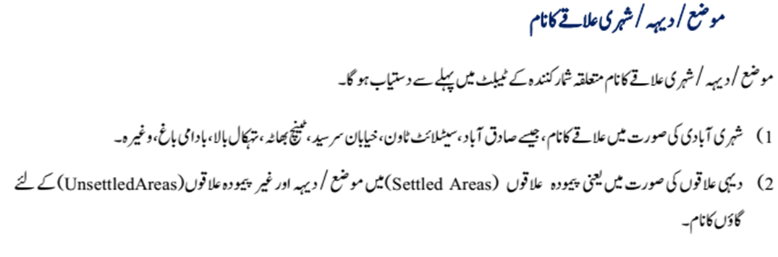
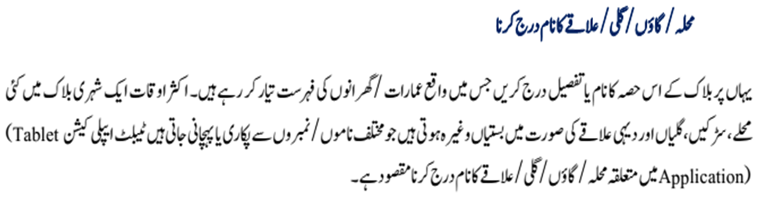
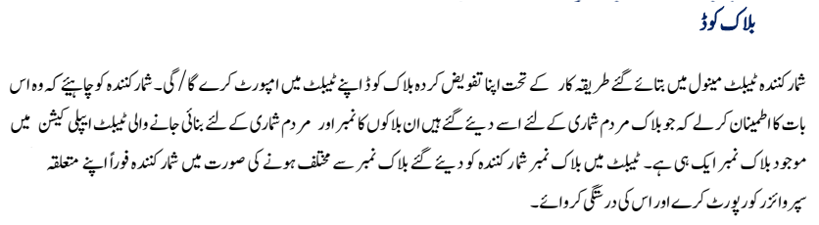


Slide 25
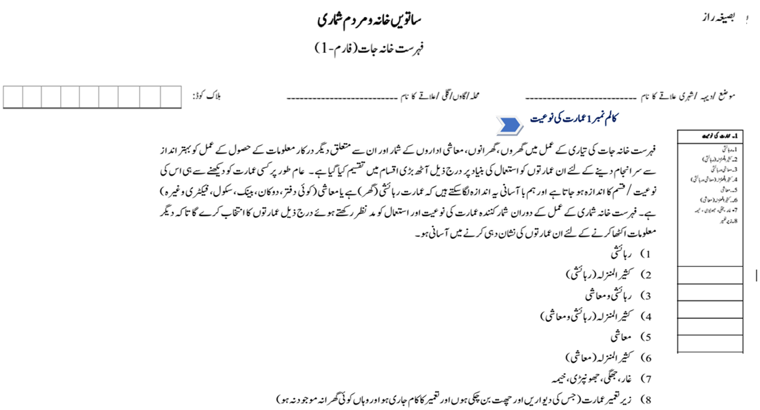

Slide 26
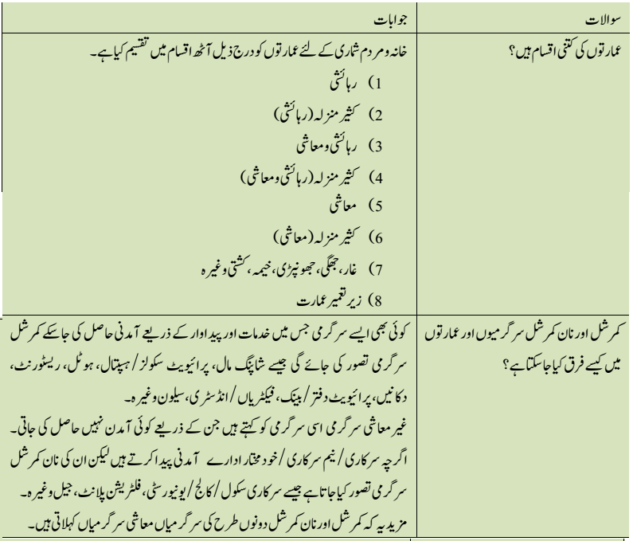
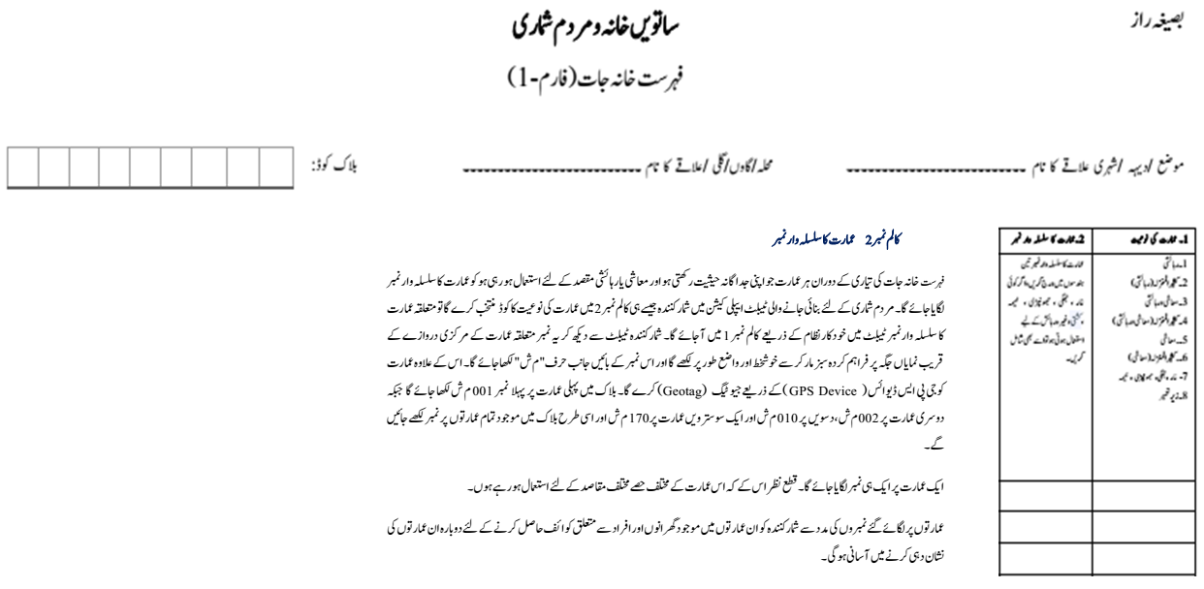
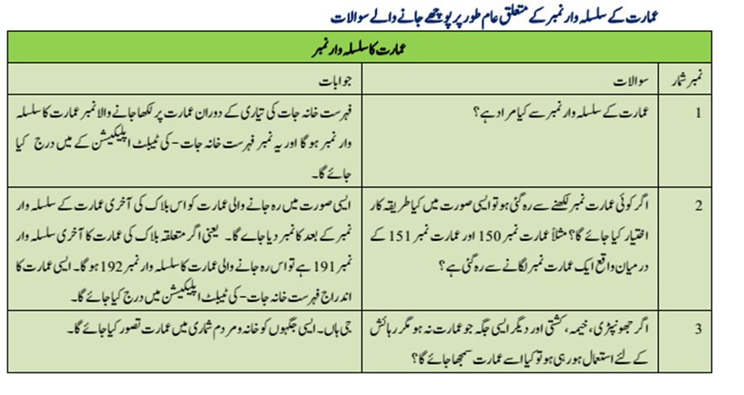
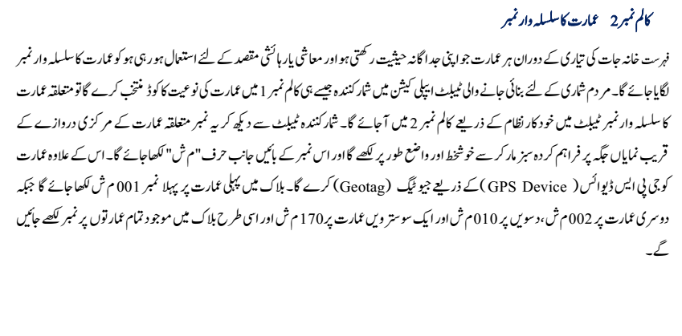
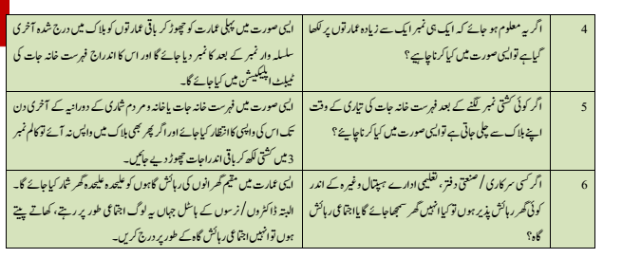


Slide 27
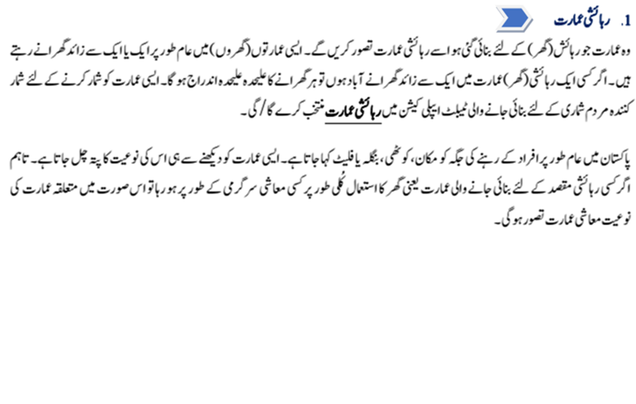
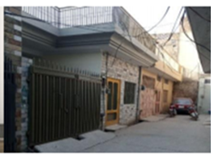
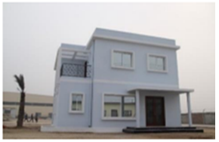
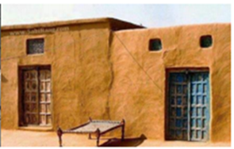

Slide 28



Slide 29



Slide 30


Slide 31


Slide 32


Slide 33







Slide 34


Slide 35





Slide 36






Slide 37




Slide 38




Slide 39




Slide 40



Slide 41





Slide 42




Slide 43




Slide 44




Slide 45







Slide 46




Slide 47


Slide 48




Slide 49




Slide 50




Slide 51



Slide 52





Slide 53


Slide 54



Slide 55


Slide 56







Slide 57






Slide 58




Slide 59






Slide 60




Slide 61





Slide 62




Slide 63



Slide 64
Objective of the session
Understand the concept of Economic Activity
What is Pakistan Standard Industrial Classification (PSIC)
How to assign codes from PSIC
64

Slide 65


DEFINITION OF ECONOMIC ACTIVITY
An economic activity is a process that leads to the production of goods or provision of services.
All activities which we perform in exchange for money or things of value are economic activities.
Economic activity is produced in a household or in an establishment
Economic activities produced by household are covered under Q.9 of listing form – 12 activities are covered under this Question
Activities produced and consumed by the household themselves will not be covered
65

Slide 66

PAKISTAN STANDARD INDUSTRIAL CLASSIFICATION
The classification of activities divides economic activities into categories which, by aggregation, make it possible to define the sectors of activity (Agriculture, Industry, Construction, Trade, etc.).
International Standard Industrial Classification of All Economic Activities (ISIC)
ISIC is a classification according to kind of economic activity
Classification is based on the Pakistan Standard Industrial Classification (PSIC) 2010
66

Slide 67
DESCRIPTION OF PSIC
Section Divisions Description
A 01–03 Agriculture, forestry and fishing
B 05–09 Mining and quarrying
C 10–33 Manufacturing
D 35 Electricity, gas, steam and air conditioning supply
E 36–39 Water supply; sewerage, waste management and remediation activities
F 41–43 Construction
G 45–47 Wholesale and retail trade; repair of motor vehicles and motorcycles
H 49–53 Transportation and storage
I 55–56 Accommodation and food service activities
J 58–63 Information and communication
K 64–66 Financial and insurance activities
L 68 Real estate activities
M 69–75 Professional, scientific and technical activities
N 77–82 Administrative and support service activities
O 84 Public administration and defence; compulsory social security
P 85 Education
Q 86–88 Human health and social work activities
R 90–93 Arts, entertainment and recreation
S 94–96 Other service activities
T 99 Activities of Extraterritorial organizations and bodies

Slide 68
FEW CLARIFICATIONS
PSIC code will be assigned to activities produced by establishments
For establishments engaged in more than one economic activity, code of principal activity will be assigned
For establishments: 01 code will be assigned to those which are engaged in corporate farming of livestock activities such as sheep farms, cattle farms etc
Principal activity is activity that contributes most to the value added (earns most).
Economic activity operating in a fixed location will be covered.
Activities such as travelling salesmen, mobile traders, fishermen without fixed place, drivers of the taxis, buses and trucks etc will not be covered.
68

Slide 69
Allocation of PSIC
Codes | Description | Economic Activities
1 | Crop and animal production, hunting and related service activities | باڈہ
2 | Forestry and logging | دیگر
3 | Fishing and aquaculture | دیگر
5 | Mining of coal and lignite | دیگر
6 | Extraction of crude petroleum and natural gas | دیگر
7 | Mining of metal ores | دیگر
8 | Other mining and quarrying | دیگر
9 | Mining support service activities | دیگر
10 | Manufacture of food products | کارخانہ/دکان پیداوار
11 | Manufacture of beverages | کارخانہ/دکان پیداوار
12 | Manufacture of tobacco products | کارخانہ/دکان پیداوار
13 | Manufacture of textiles | کارخانہ/دکان پیداوار
14 | Manufacture of wearing apparel | کارخانہ/دکان پیداوار
15 | Manufacture of leather and related products | کارخانہ/دکان پیداوار
16 | Manufacture of wood and of products of wood and cork, except furniture; manufacture of articles of straw and plaiting materials | کارخانہ/دکان پیداوار
17 | Manufacture of paper and paper products | کارخانہ
18 | Printing and reproduction of recorded media | کارخانہ/دکان پیداوار
69

Slide 70
Allocation of PSIC
Codes | Description | Economic Activities
19 | Manufacture of coke and refined petroleum products | کارخانہ
20 | Manufacture of chemicals and chemical products | کارخانہ/دکان پیداوار
21 | Manufacture of basic pharmaceutical products and pharmaceutical preparations | کارخانہ
22 | Manufacture of rubber and plastics products | کارخانہ
23 | Manufacture of other non-metallic mineral products | کارخانہ
24 | Manufacture of basic metals | کارخانہ
25 | Manufacture of fabricated metal products, except machinery and equipment | کارخانہ/دکان پیداوار
26 | Manufacture of computer, electronic and optical products | کارخانہ
27 | Manufacture of electrical equipment | کارخانہ
28 | Manufacture of machinery and equipment n.e.c. | کارخانہ
29 | Manufacture of motor vehicles, trailers and semi-trailers | کارخانہ
30 | Manufacture of other transport equipment | کارخانہ
31 | Manufacture of furniture | کارخانہ/دکان پیداوار
32 | Other manufacturing | کارخانہ/دکان پیداوار
33 | Repair and installation of machinery and equipment | کارخانہ/ دکان خدمات
35 | Electricity, gas, steam and air conditioning supply | نیم سرکاری دفتر/ سرکاری دفتر
36 | Water collection, treatment and supply | نیم سرکاری دفتر/ سرکاری دفتر
37 | Sewerage | نیم سرکاری دفتر/ سرکاری دفتر
38 | Waste collection, treatment and disposal activities; materials recovery | نیم سرکاری دفتر/ سرکاری دفتر
70

Slide 71
Allocation of PSIC
Codes | Description | Economic Activities
39 | Remediation activities and other waste management services | دیگر
41 | Construction of buildings | دیگر
42 | Civil engineering | نیم سرکاری دفتر/ سرکاری دفتر/دیگر
43 | Specialized construction activities | نیم سرکاری دفتر/ سرکاری دفتر/دیگر
45 | Wholesale and retail trade and repair of motor vehicles and motorcycles | ہول سیل دکان/ ریٹیل شاپ
46 | Wholesale trade, except of motor vehicles and motorcycles | ہول سیل دکان
47 | Retail trade, except of motor vehicles and motorcycles | ریٹیل شاپ
49 | Land transport and transport via pipelines | نیم سرکاری دفتر/ سرکاری دفتر/دیگر
50 | Water transport | نیم سرکاری دفتر/ سرکاری دفتر/دیگر
51 | Air transport | نیم سرکاری دفتر/ سرکاری دفتر/دیگر
52 | Warehousing and support activities for transportation | نیم سرکاری دفتر/ سرکاری دفتر/دیگر
53 | Postal and courier activities | نیم سرکاری دفتر/ سرکاری دفتر/دیگر
55 | Accommodation | ہاسٹل
56 | Food and beverage service activities | ہوٹل
71

Slide 72
Allocation of PSIC
Codes | Description | Economic Activities
58 | Publishing activities | دکان خدمات
59 | Motion picture, video and television programme production, sound recording and music publishing activities | دکان خدمات
60 | Programming and broadcasting activities | دکان خدمات
61 | Telecommunications | دکان خدمات
62 | Computer programming, consultancy and related activities | دکان خدمات
63 | Information service activities | دکان خدمات
64 | Financial service activities, except insurance and pension funding | بینک
65 | Insurance, reinsurance and pension funding, except compulsory social security | نیم سرکاری دفتر/ سرکاری دفتر
66 | Activities auxiliary to financial service and insurance activities | دکان خدمات
68 | Real estate activities | پراپرٹی ڈیلر
69 | Legal and accounting activities | دکان خدمات
70 | Activities of head offices; management consultancy activities | دکان خدمات
71 | Architectural and engineering activities; technical testing and analysis | دیگر
72 | Scientific research and development | دیگر
73 | Advertising and market research | دیگر
74 | Other professional, scientific and technical activities | دیگر
75 | Veterinary activities | دکان خدمات
77 | Rental and leasing activities | دکان خدمات
72

Slide 73
Allocation of PSIC
Codes | Description | Economic Activities
78 | Employment activities | دیگر
79 | Travel agency, tour operator, reservation service and related activities | دیگر
80 | Security and investigation activities | دیگر
81 | Services to buildings and landscape activities | دیگر
82 | Office administrative, office support and other business support activities | دکان خدمات
84 | Public administration and defence; compulsory social security | سرکاری دفتر/جیل/تھانہ
85 | Education | سکول/کالج/یونیورسٹی
86 | Human health activities | یتیم خانہ/اولڈ ہوم/دار ال امان / ہسپتال
87 | Residential care activities | دیگر
88 | Social work activities without accommodation | دیگر
90 | Creative, arts and entertainment activities | دیگر
91 | Libraries, archives, museums and other cultural activities | دیگر
92 | Gambling and betting activities | دیگر
93 | Sports activities and amusement and recreation activities | دیگر
94 | Activities of membership organizations | مدرسہ/مسجد/عبادت گاہ
95 | Repair of computers and personal and household goods | دکان خدمات
96 | Other personal service activities | دکان خدمات
99 | Activities of extraterritorial organizations and bodies | دیگر
73

Slide 75


