Slide 1


PRESENTATION ON
CENSUS-2017
26.03.2021
MINISTRY OF PLANNING, DEVELOPMENT & SPECIAL INITIATIVES

Slide 2

CCI’S DECISION 16th DEC. 2016
In pursuance of the Supreme Court decision to take Census from 15 Mar. 2017, a summary was submitted to the CCI.
The CCI in its meeting held on 16th Dec. 2016 decided as under:-
Census may be held on traditional method using paper based questionnaires starting from 15th March, 2017 under the supervision of the Armed Forces.
House Listing and Census Operation may be carried out in one go. Form-2 only may be used in the Census Operation, while Form 2-A may be filled in on sample basis, after the Census Operation is over.
Census may be held in two phases, each phase may be carried out in all the provinces simultaneously.
Notes:
2
2

Slide 3
BUDGET
A sum of Rs. 18.5 billion was sanctioned for the Census 2017 for the following heads:
  Remuneration for field staff Rs 6.00 billion
  Hiring of Transport for field teams Rs 6.50 billion
  Deployment of Armed Forces Rs 6.00 billion
The budget for field staff remuneration and hiring of transport was transferred to the Deputy Commissioner / Census District Officers.
Notes:
3
3

Slide 4
PREPARATIONS FOR FIELD OPERATION
All the Census field staff (Teachers, Revenue Staff etc) was drawn from departments of respective Provincial Government
Appointment of Census field staff by the Census District Officers. (DC / AC, Cantonment Executive Officers)
Training of 120,000 civil enumerators, supervisors and superintendents.
For the timely compilation of Census-2017 results a dedicated setup for scanning / processing of data at PBS, Hqs Islamabad was established as done in 1998 Census.

Slide 5
DEPLOYMENT OF ARMED FORCES
    Around 200,000 Army Personnel were deployed on Census duty.
    44,000 Army Personnel were deployed for enumeration work with 5% reserve staff.
    Remaining Army Personnel were used for provision of security to the field staff. Civil Armed Forces and local police force helped in maintaining law and order.

Slide 6
ADMINISTRATIVE ARRANGEMENTS
For complete coverage and effective field supervision, the country has been delimited on four tier system.
SET UP | COMPRISING OF
Census District | District / Tehsils/ Taluka / Cantonments / Agencies
Census Charge | Qanungo Halqa / Part of Urban Area / Cantonment 5 To 7 Circles in Charge
Census Circle | Patwar Circle/ Part of Urban Area / Cantonment. 5 To 7 Blocks in a Circle 1500 houses on an average
Census Block | 200 To 250 Houses on an average

Slide 7
CENSUS AREAS BY ADMIN. UNITS
ADMINISTRATIVE UNIT | Admn District | Census District | Census Charges | Census Circles | Census Blocks
KP | 25 | 82 | 342 | 2,316 | 21,577
FATA | 07 | 07 | 48 | 288 | 4,227
Punjab | 36 | 166 | 1,561 | 11,414 | 87,006
Sindh | 29 | 146 | 933 | 5,144 | 39,139
Balochistan | 32 | 36 | 285 | 784 | 10,212
Islamabad | 01 | 01 | 14 | 107 | 1,514
AJK | 10 | 10 | 95 | 463 | 4,022
GB | 10 | 10 | 35 | 141 | 1,246
Total | 150 | 458 | 3,313 | 20,657 | 168,943

Slide 8
MONITORING MECHANISM
Map of each census block showing well known land marks provided to Enumerators / Supervisors.
Vigilance Teams at Census District level monitored census work and ensured complete coverage.
Coordination Committees at Provincial / Admin / Census District level for coordination & supervision of Census operation.
Centralized Complaint Center (UAN: 0800 57574) was setup at PBS, Hqs and advertised for redressal of complaints.
Five International Observer Teams visited different parts of the country.

Slide 9
METHODOLOGY OF FIELD OPERATION
Census has been conducted in two phases
Each phase had a duration of 30 days
Two blocks were assigned to one Enumerator in the same area
Each Block was completed in 14 days with first 3 days for House Listing, 10 days for filling-up of Form-2 and one day for enumeration of homeless population
One soldier accompanied each enumerator supported by Local Police / Civil Armed Forces
Gap of 10 days was retained due to shifting of Armed Forces from areas of phase-I to areas of phase-II

Slide 10
CENSUS IN PHASES
    In phase-I, field operation started from 15th March, 2017 and concluded on 13th April, 2017
    Census in 61 Admin Districts was completed
In phase-II, Census Operation started on 25th April and completed on 24th May 2017.
Census in 89 Admin Districts was completed
However, for redressal of complaints, enumeration period was extended up to 30th May, 2017

Slide 11
PREPARATIONS FOR PROVISIONAL RESULTS
Provisional results were prepared on the basis of Block level summary (REN-2) Form
ADMN UNIT | POPULATION (mill) |  |  | PROVINCIAL SHARE %
 | 1981 | 1998 | 2017 | 1981 | 1998 | 2017
PAKISTAN | 84.25 | 132.35 | 207.77 | 100.0 | 100.0 | 100.0
KP | 11.06 | 17.74 | 30.52 | 13.12 | 13.41 | 14.69
FATA | 2.20 | 3.18 | 5.00 | 2.60 | 2.40 | 2.41
PUNJAB | 47.29 | 73.62 | 110.01 | 56.13 | 55.63 | 52.95
SINDH | 19.03 | 30.44 | 47.89 | 22.58 | 23.00 | 23.05
BALOCHISTAN | 4.33 | 6.57 | 12.34 | 5.14 | 4.96 | 5.94
ISLAMABAD | 0.34 | 0.81 | 2.01 | 0.40 | 0.61 | 0.97
Notes:
11
11

Slide 12
APPROVAL OF PROVISIONAL RESULTS OF CENSUS-2017
Provisional Summary results were published on 25.08.2017
However, Chief Minister Sindh and MQM raised question on Census results
Subsequently, Ex-Senator Taj Haider presented figures pertaining population of Karachi alleging that its record of NADRA which created controversy
However, Chairman NADRA through letter and in person denied this record belongs to NADRA
Notes:
12
12

Slide 13
APPROVAL OF PROVISIONAL RESULTS OF CENSUS-2017
CCI on 13.11.2017 approved the block wise provisional results and directed to conduct 3rd Party Validation of 1% blocks proportionately in each province
Subsequently CCI on 24.11.2017 decided to enhance the sampling proportion of census blocks from 1% to 5%
PBS initiated biding process for hiring of 3rd Party and accordingly 12 firms were shortlisted
Parliamentary Leaders of the Political Parties in Senate held a meeting on 15.12.2017 chaired by the then Prime Minister, and agreed to form a Committee of Senators to supervise and oversee the activities of 5% Validation Exercise in the background of 24th Constitutional Amendment
Notes:
13
13

Slide 14
APPROVAL OF PROVISIONAL RESULTS OF CENSUS-2017
The provisional results of Census-2017 were used after 24th Constitutional Amendment for delimitation and allocation of seats for General Elections -2018
However, Senator Taj Haider objected on the process of hiring of 3rd party for validation exercise and also submitted adjournment motion in the Senate on 15.02.2018
The Chairman Senate directed Statistics Division not to proceed in the matter till meeting with the Leader of the House (Senator Raja Zafar-ul-Haq) along with Senator Taj Haider. Meeting was held on 19.03.2018 but no consensus was arrived
Resultantly the process for hiring of 3rd Party was halted
Notes:
14
14

Slide 15
APPROVAL OF PROVISIONAL RESULTS OF CENSUS-2017
Regarding role of Senator’s Committee, the PM, on 9th March, 2018 directed to take issue of 3rd party validation to CCI. CCI on 27.03.2018 reiterated its earlier decision regarding 5% validation through 3rd Party
The Prime Minister on a subsequent presentation 30.04.2018 by PBS regarding legal issues in 3rd Party validation exercise directed to take the matter again to CCI
In CCI meeting of 27th May, 2018, PBS informed of the following limitations:
    As per international standards recommended by the International Agencies, Post Evaluation Survey must be at the heels of main operation, and not possible after six months
    Similar environment is pre requisite to conduct the post enumeration survey
    Reconciliation after 5% exercise would be impractical, jeopardising 95% national census data
Notes:
15
15
PBS initiated biding process on 13.12.2017,for third party validation, 12 firms shortlisted.
Process for finalization of methodology for third party validation stopped on direction of chairman senate on 15.02.2018
Meeting with leader of the house in Senate Mr. Raja ZafrulHaq was held on 19.03.2018, but no decision made , however question of inclusion of
Members of National assembly in the oversight committee was raised.
Resultantly the whole process halted.

Slide 16
APPROVAL OF FINAL RESULTS OF CENSUS-2017
CCI decided:
Decision No. 1
“ Regarding conduct of 5% Census / validation exercise, the Chairman, CCI appreciated the viewpoint of Statistics Division in terms of legal, practical and financial limitation as explained by the Statistics Division and agreed that holding of 5% validation exercise at this belated stage is not workable/ practical. However, since the matter was referred to CCI by the Parliament, therefore, Prime Minister suggested that issue of 5% Validation Exercise may be referred back to Parliament for appropriate debate / decision”.
Notes:
16
16

Slide 17
APPROVAL OF FINAL RESULTS OF CENSUS-2017
Decision No. 2
“The Chairman CCI while considering the proposal of Ministry of Statistics regarding approval / release of the final results of Census 2017 mentioned that since the government has already made the 24th Constitutional Amendment for using provisional Census 2017 result for the forthcoming election 2018 and the subsequent by-elections, hence releasing of final result at this stage may affect the delimitation exercise being carried out by the Election Commission of Pakistan. The proposal of approval / release of final result of Census may be deferred for the time being and may be placed before the incoming Government”.
Notes:
17
17

Slide 18
APPROVAL OF FINAL RESULTS OF CENSUS-2017
Summary for PM was submitted on 06.09.2018 with the following proposals:
  The matter may be referred to Parliament by the Federal Government as recommended by CCI for decision.
  CCI may be requested to revise its decision dated 27.05.2018 for referring the matter to Parliament and take appropriate decision to approve final results of Census – 2017
PM office inquired if the matter of 5% Validation Exercise was referred by the Parliament
PBS replied that the matter has not been formally referred by Parliament
Notes:
18
18

Slide 19
APPROVAL OF FINAL RESULTS OF CENSUS-2017
A summary was submitted to CCI with the proposal that the CCI may defer the agenda of issuance of final results of Census-2017 to allow deliberations with the stakeholders and to re-submit the matter with appropriate proposals for consideration of the CCI.
Matter was on agenda of CCI on 23.12.2019. However, The agenda was not taken up due to paucity of time.
Accordingly, summary for the Cabinet was submitted with the proposal the Cabinet may consider constituting a committee of the Cabinet to deliberate and make recommendations for finalization of the results of Census – 2017.
Five Members Cabinet Committee constituted on 11.02.2020.
Notes:
19
19

Slide 20
COMPOSITION OF THE MINISTER’S COMMITTEE
I | Mr. Ali Haider Zaidi, Minister for Maritime Affairs | Convener
ii. | Dr. Fehmida Mirza, Minister for Inter-provincial Coordination | Member
iii. | Mr. Nur-ul-Haq Qadri, Minister for Religious Affairs & Interfaith Harmony. | Member
iv. | Dr. Zubaida Jalal, Minister for Defence Production | Member
v. | Dr. Muhammad Farogh Naseem, Minister for Law & Justice replaced by Syed Amin ul Haq, Minister for Information Technology and Telecommunication | Member
Notes:
20
20

Slide 21
MINISTER’S COMMITTEE RECOMMENDATIONS / REPORT
Six meetings of the Cabinet Committee were held and
the Committee submitted following recommendations:-
In the larger national interest, 6th Population and Housing Census-2017 should be accepted as final- although there are reservations on the said census.
Next Census should be held at the earliest possible time – which may be determined after input from the stakeholder; and may be held before lapse of period of 10-years from the date of 6th Population and Housing Census 2017.
Notes:
21
21

Slide 22
MINISTER’S COMMITTEE RECOMMENDATIONS / REPORT
Use of technology should be ensured in order to remove doubts / concerns that were expressed in respect of 6th Population and Housing Census-2017 and the same do-not re-occur.
A Committee may be constituted under Ministry of Information Technology comprising of NADRA, Election Commission of Pakistan, Pakistan Bureau of Statistics – with the mandate to suggest optimum use of technology to achieve objectives of Census reflecting the ground realities.
The report of the Cabinet Committee was presented before the Cabinet on 22.12.2020 and the Cabinet approved to present the report before the CCI.
Notes:
22
22

Slide 23
SALIENT FEATURES OF FINAL RESULTS
CENSUS-2017
Notes:
23
23

Slide 24
SALIENT FEATURES OF FINAL CENSUS-2017
According to the final results, the population of the country is:
 | POPULATION (mill) |  |  | ANNUAL GROWTH RATE %
 | 1981 | 1998 | 2017 | 1981 | 1998 | 2017
PAKISTAN | 84.25 | 132.35 | 207.68 | 3.06 | 2.69 | 2.40
The population of Country in Provisional Results was shown as 207.77 Million with difference observed that -0.043%.
Notes:
24
24

Slide 25
PROVINCIAL SHARES IN NATIONAL POPULATION
ADMN UNIT | POPULATION (mill) |  |  | PROVINCIAL SHARE %
 | 1981 | 1998 | 2017 | 1981 | 1998 | 2017
PAKISTAN | 84.25 | 132.35 | 207.68 | 100.0 | 100.0 | 100.0
KP | 11.06 | 17.74 | 30.51 | 13.12 | 13.41 | 14.69
FATA | 2.20 | 3.18 | 4.99 | 2.60 | 2.40 | 2.40
PUNJAB | 47.29 | 73.62 | 109.99 | 56.13 | 55.63 | 52.96
SINDH | 19.03 | 30.44 | 47.85 | 22.58 | 23.00 | 23.04
BALOCHISTAN | 4.33 | 6.57 | 12.34 | 5.14 | 4.96 | 5.94
ICT | 0.34 | 0.81 | 2.00 | 0.40 | 0.61 | 0.96
Notes:
25
25

Slide 26
CENSUS-2017: POPULATION AVERAGE ANNUAL GROWTH RATE
ADMN UNITS | POPULATION (mill) |  |  | ANNUAL GROWTH RATE %
 | 1981 | 1998 | 2017 | 1981 | 1998 | 2017
PAKISTAN | 84.25 | 132.35 | 207.68 | 3.06 | 2.69 | 2.40
KP | 11.06 | 17.74 | 30.51 | 3.32 | 2.82 | 2.89
FATA | 2.20 | 3.18 | 4.99 | -1.47 | 2.19 | 2.40
PUNJAB | 47.29 | 73.62 | 109.99 | 2.74 | 2.64 | 2.13
SINDH | 19.03 | 30.44 | 47.85 | 3.56 | 2.80 | 2.41
BALOCHISTAN | 4.33 | 6.57 | 12.34 | 7.09 | 2.47 | 3.37
ICT | 0.34 | 0.81 | 2.00 | 4.49 | 5.19 | 4.90
Notes:
26
26

Slide 27
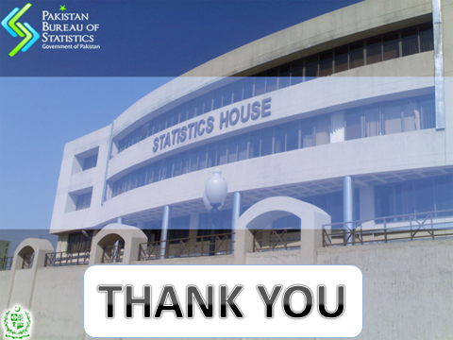
THANK YOU

Slide 28
MAIN POINTS RAISED ON CENSUS RESULTS
Population growth of Karachi is lower than Lahore.
Population of several blocks reported as zero but they have voters.
There is a big difference in population reported and registered voters.

Slide 29
Lahore – Karachi Growth Rate
Boundary definitional issue.
Urban/ rural boundaries are defined by Local Governments.
Lahore district is notified as Lahore city in 2015, and 3 million population is added in Lahore city population only due to extension
Karachi City extension was limited to inclusion of Seven Dehs.(Population of 0.598 million with growth rate 9.50 added in population of 2017.
Population of Karachi city increased by 5.4 6 million during 1998-2017
Notes:
Lahore district is notified as Lahore city in 2015, and 3 million population is added in Lahore city population only due to extension.
Karachi city extension is only limited to inclusion 7 dehs in 2013 , adding only 0.598 million population in Karachi city population
Population of Karachi city increased by 5.4 6 million during 1998-2017
Population of Lahore city district increased by 5.98 million including 3 million due to extension in boundary. This means the increase in population of Lahore city is 2.98 million as compared to 5.46 million in Karachi city .

Slide 30
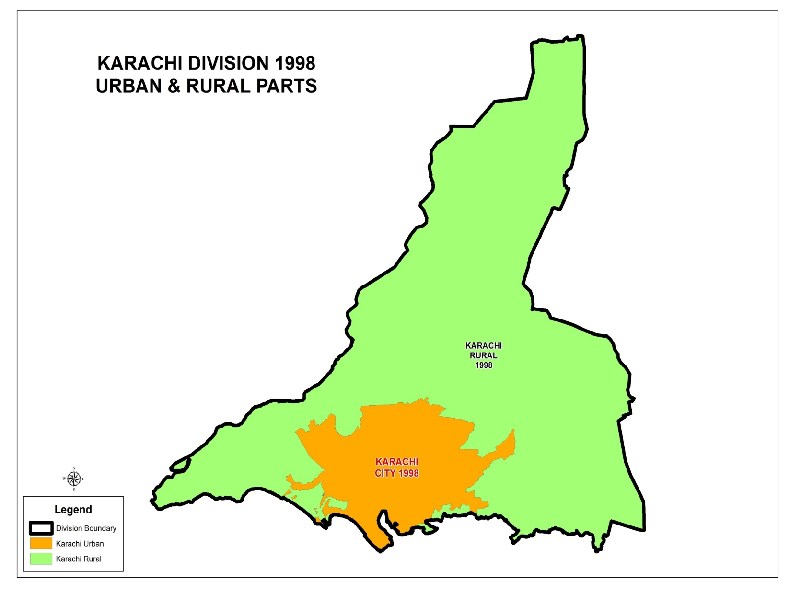
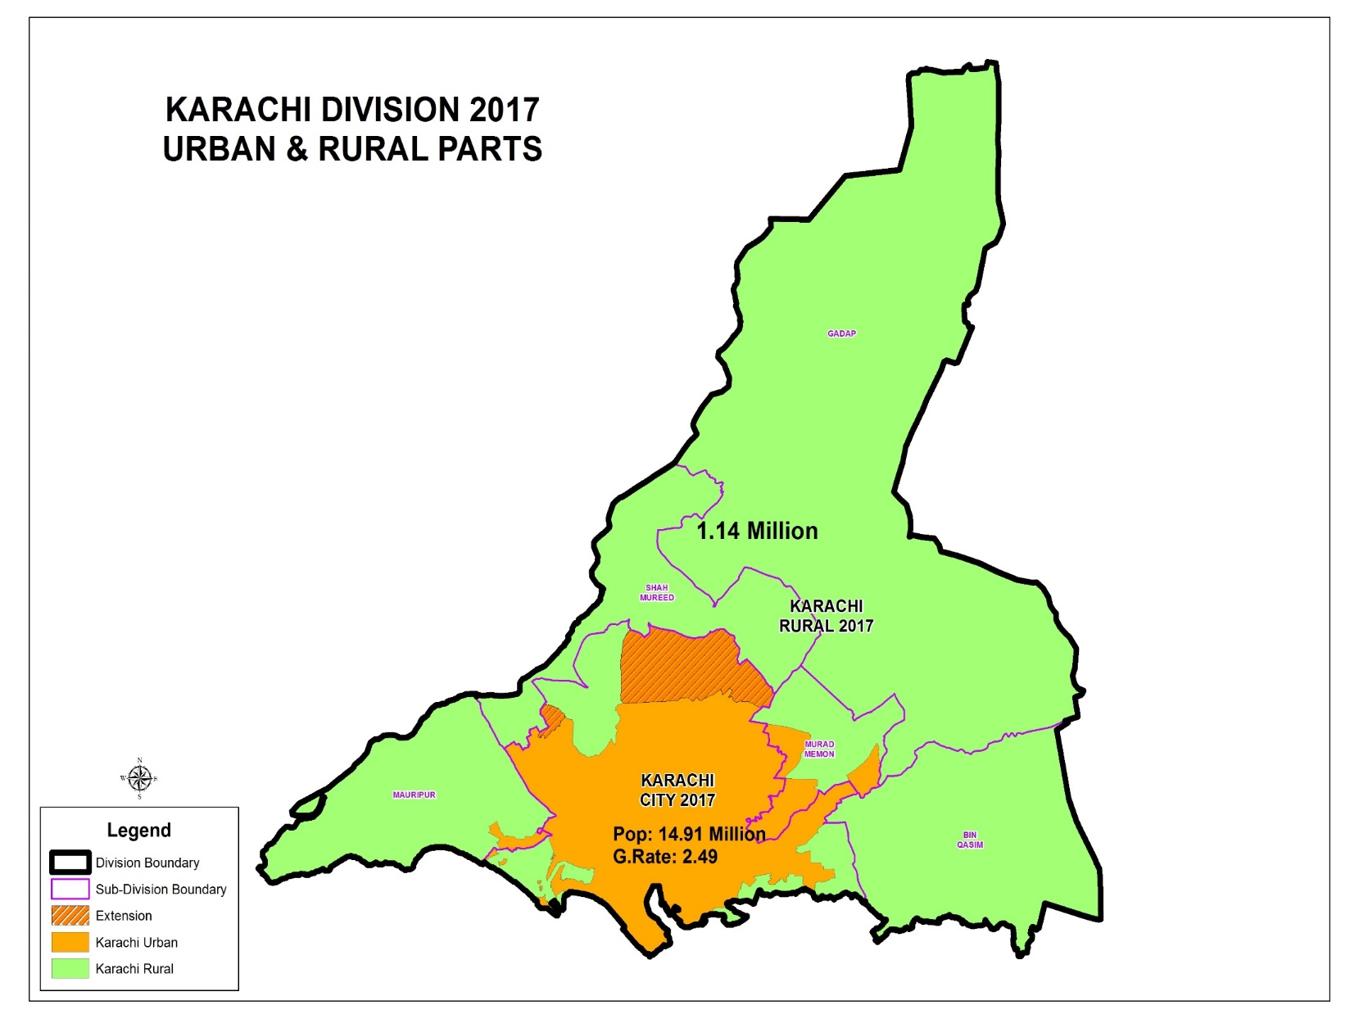
Voters : 7.94 million
CNIC Issued: 8.51 million
Pop: 16,051,521
G.Rate:2.60
0.52 Million
G.Rate:5.56
Pop: 598,446
G.Rate:9.50
9.339 Million

Slide 31
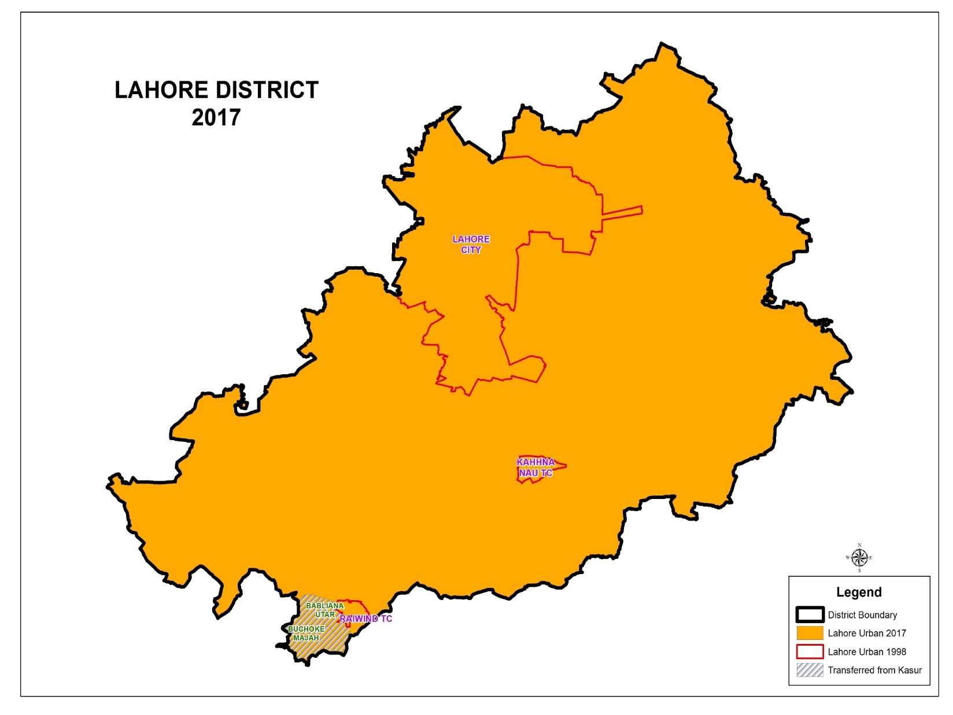
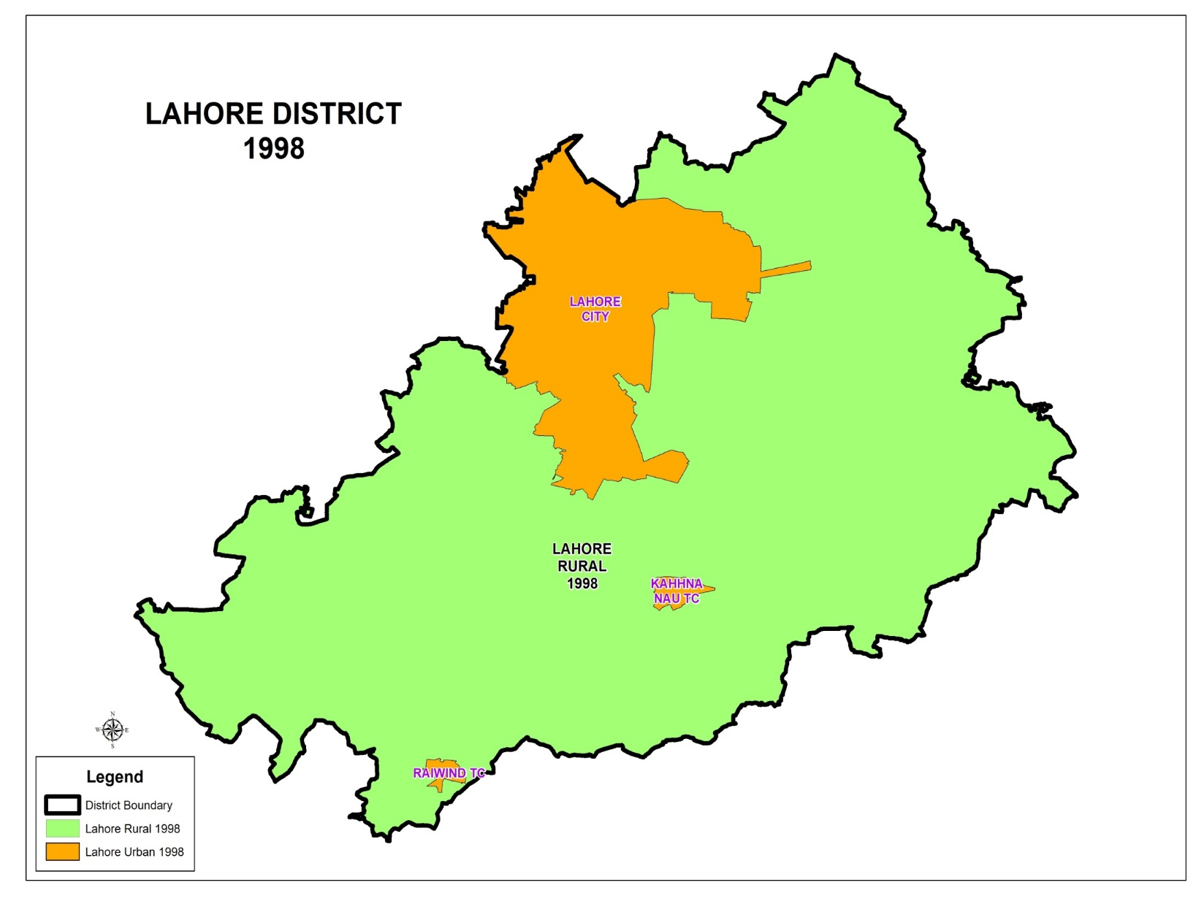
Pop: 8,123,193
G.Rate:2.43
Voters : 4.94 million
CNIC Issued: 5.99 million
5,143,495
Lahore City /District Pop: 11,126,285
G.Rate:2.98
Pop: 2,956,106
G.Rate:4.9
RURAL as Per 1998
1,196,619
Pop: 46,986
G.Rate:4.23

Slide 32
Lahore – Karachi Growth Rate
LAHORE CITY DISTRICT | Population 1998 | Population 2017 | Growth Rate | Percentage Change
Urban(as per 1998) | 5,143,495 | 8,123,193 | 2.43 | 57.93
Rural (as per 1998) | 1,196,619 | 2,956,106 | 4.9 | 147.03
Sub total | 6,340,114 | 11,079,299 | 2.98 | 74.75
Two UCs of Kasur added | 21,369 | 46,986 | 4.23 | 119.88
Total | 6,361,483 | 11,126,285 | 2.98 | 74.90
KARACHI DIVISION
Urban(as per 1998) | 9,448,808 | 14,910,352 | 2.49 | 57.80
Rural (as per 1998) | 407,510 | 1,141,169 | 5.56 | 180.03
Total | 9,856,318 | 16,051,521 | 2.60 | 62.86
Notes:
Lahore district is notified as Lahore city in 2015, and 3 million population is added in Lahore city population only due to extension.
Karachi city extension is only limited to inclusion 7 dehs in 2013 , adding only 0.598 million population in Karachi city population
Population of Karachi city increased by 5.4 6 million during 1998-2017
Population of Lahore city district increased by 5.98 million including 3 million due to extension in boundary. This means the increase in population of Lahore city is 2.98 million as compared to 5.46 million in Karachi city .

Slide 33
BLOCKS WITH ZERO POPULATION BUT HAVE VOTES
There are 14,667 blocks in Karachi
Only Eleven blocks have issues regarding population reporting
The total voters of these blocks are 2,851 as per ECP record.
Three blocks (406010234, 407090605, 435081001) were without population at the time of Census because under water/ full market area/no household
Eight blocks’ population was covered by Enumerators in the adjacent blocks due to overlapping.
Notes:
33
33
The overlapping of blocks happened in all over country because some enumerators failed to understand the boundary of blocks on maps.
They have covered the population of other block along with with the block assigned to them

Slide 34
KARACHI BLOCKS WITH ZERO POPULATION
District | Block Code | Population | Voters | Remarks
Karachi West | 406010234 Map | 0 | 12 | Actual Zero Population Maripur area under water
 | 407090605 Map | 0 | 304 | Market area (111 structures)
 | 409110502 Map | 0 | 471 | Overlapped with block 409110509 (1650 Pop.) 210
 | 407090803 Map | 0 | 238 | Overlapped with block 407090802 (1300 Pop.) 298
Karachi East | 413120303 Map | 0 | 291 | Dubai Palace pop covered in block 413120302 (1160 Pop.) 64
 | 441080401 Map | 0 | 298 | Full market, overlapped with block 441080402 (941 Pop.) 121
Notes:
34
34

Slide 35
KARACHI BLOCKS WITH ZERO POPULATION
District | Block Code | Population | Voters | Remarks
Karachi South | 435081001 Map | 0 | 155 | Full Market area (36 Structrues) (GARDEN SUB-DIVISION)
 | 436050201 Map | 0 | 126 | Actual Zero Population as 340 dwelling units were under construction
 | 436050404 Map | 0 | 302 | Sports ground and tower marine, overlapped with block 436050410 (1073 Pop.) 345
Karachi Central | 419010403 Map | 0 | 238 | Overlap covered in 419010304 (1676 Pop.) 412
Malir | 445030307 Map | 0 | 416 | Industrial Zone , overlapped with block 445030306 (2640 Pop.) 132 (IBRAHIM HYDRI SUB-DIVISION)
Notes:
35
35

Slide 36
CLAIMS OF LESS POPULATION THAN VOTERS IN DISTRICTS OF KARACHI
According to official Data received From ECP pertaining to 2018:-
Claim that Voters are more than the population of the districts of Karachi is not supported as every district population aged 18+ is more than registered voters
Area | Population All Ages Census -2017 | AGE 18 + Population Census -2017 | % of population 18+ | No. of Voters 2018* | % of voters to total Population
1 | 2 | 3 | 4 | 5 | 6
KARACHI DIVISION | 16,024,894 | 9,649,732 | 60.22 | 8,107,186 | 50.51
LAHORE | 11,119,985 | 6,677,924 | 60.05 | 5,398,623 | 48.52
ISLAMABAD | 2,003,368 | 1,207,031 | 60.25 | 765,348 | 38.14
* Voters are per Record of ECP as per February 2018

Slide 37
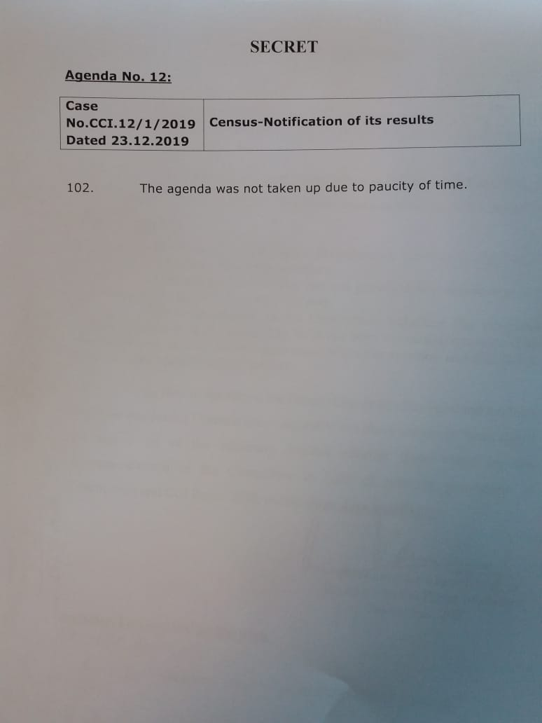

Slide 38
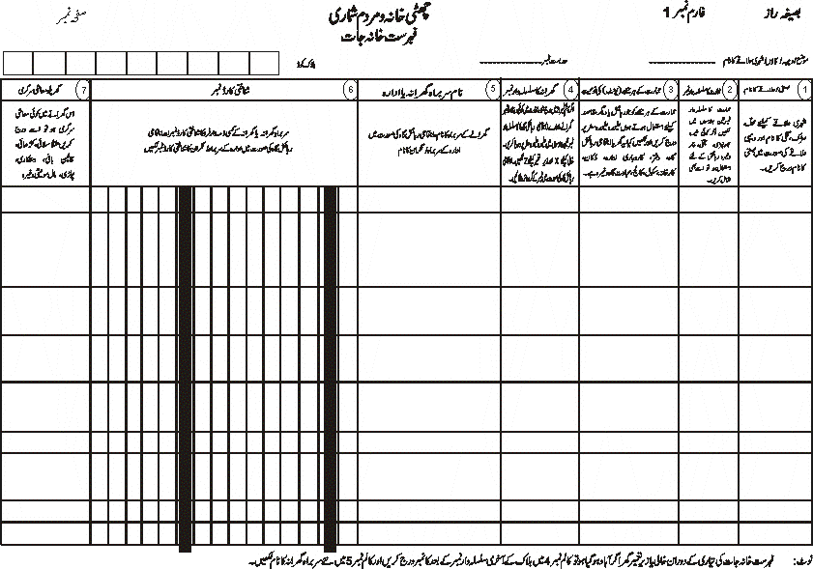

Slide 39
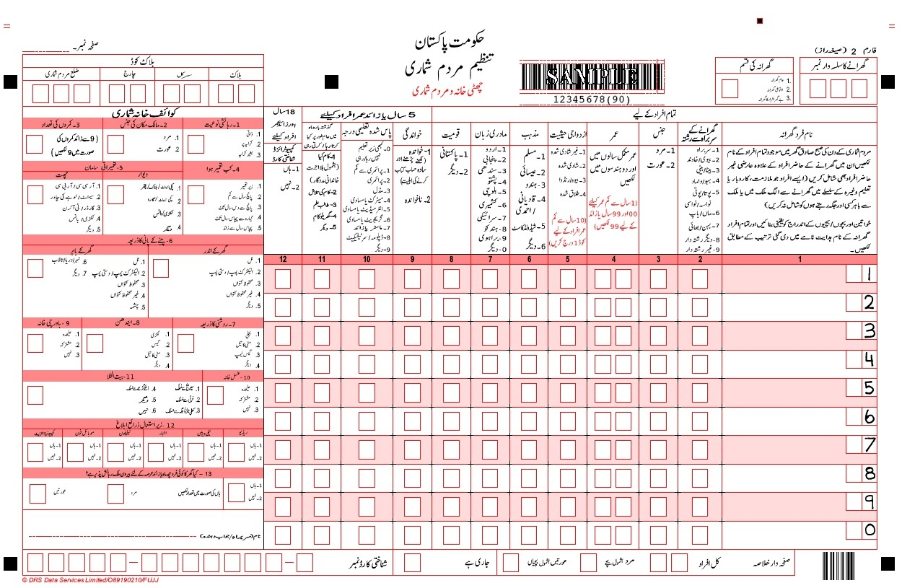

Slide 40
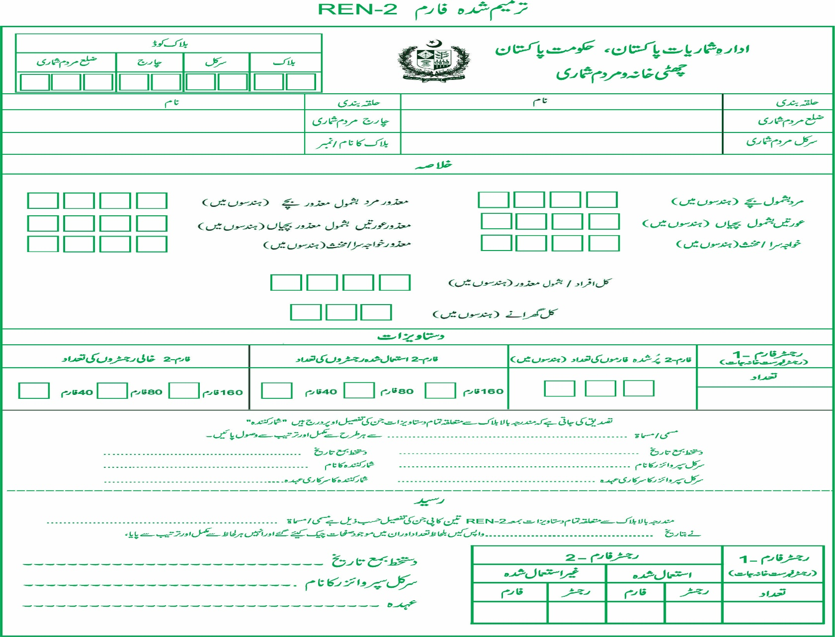

Slide 41
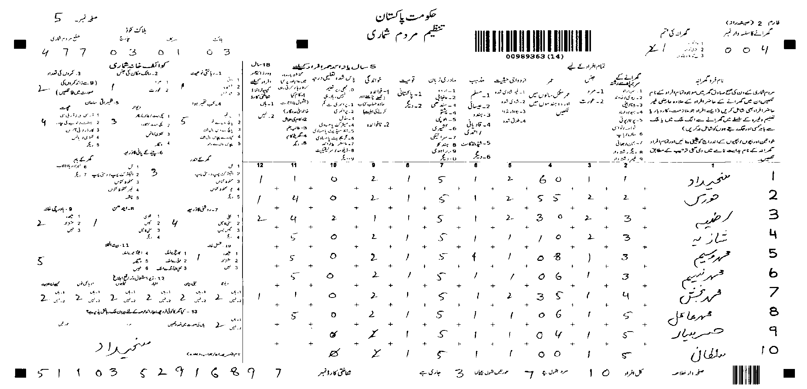

Slide 42
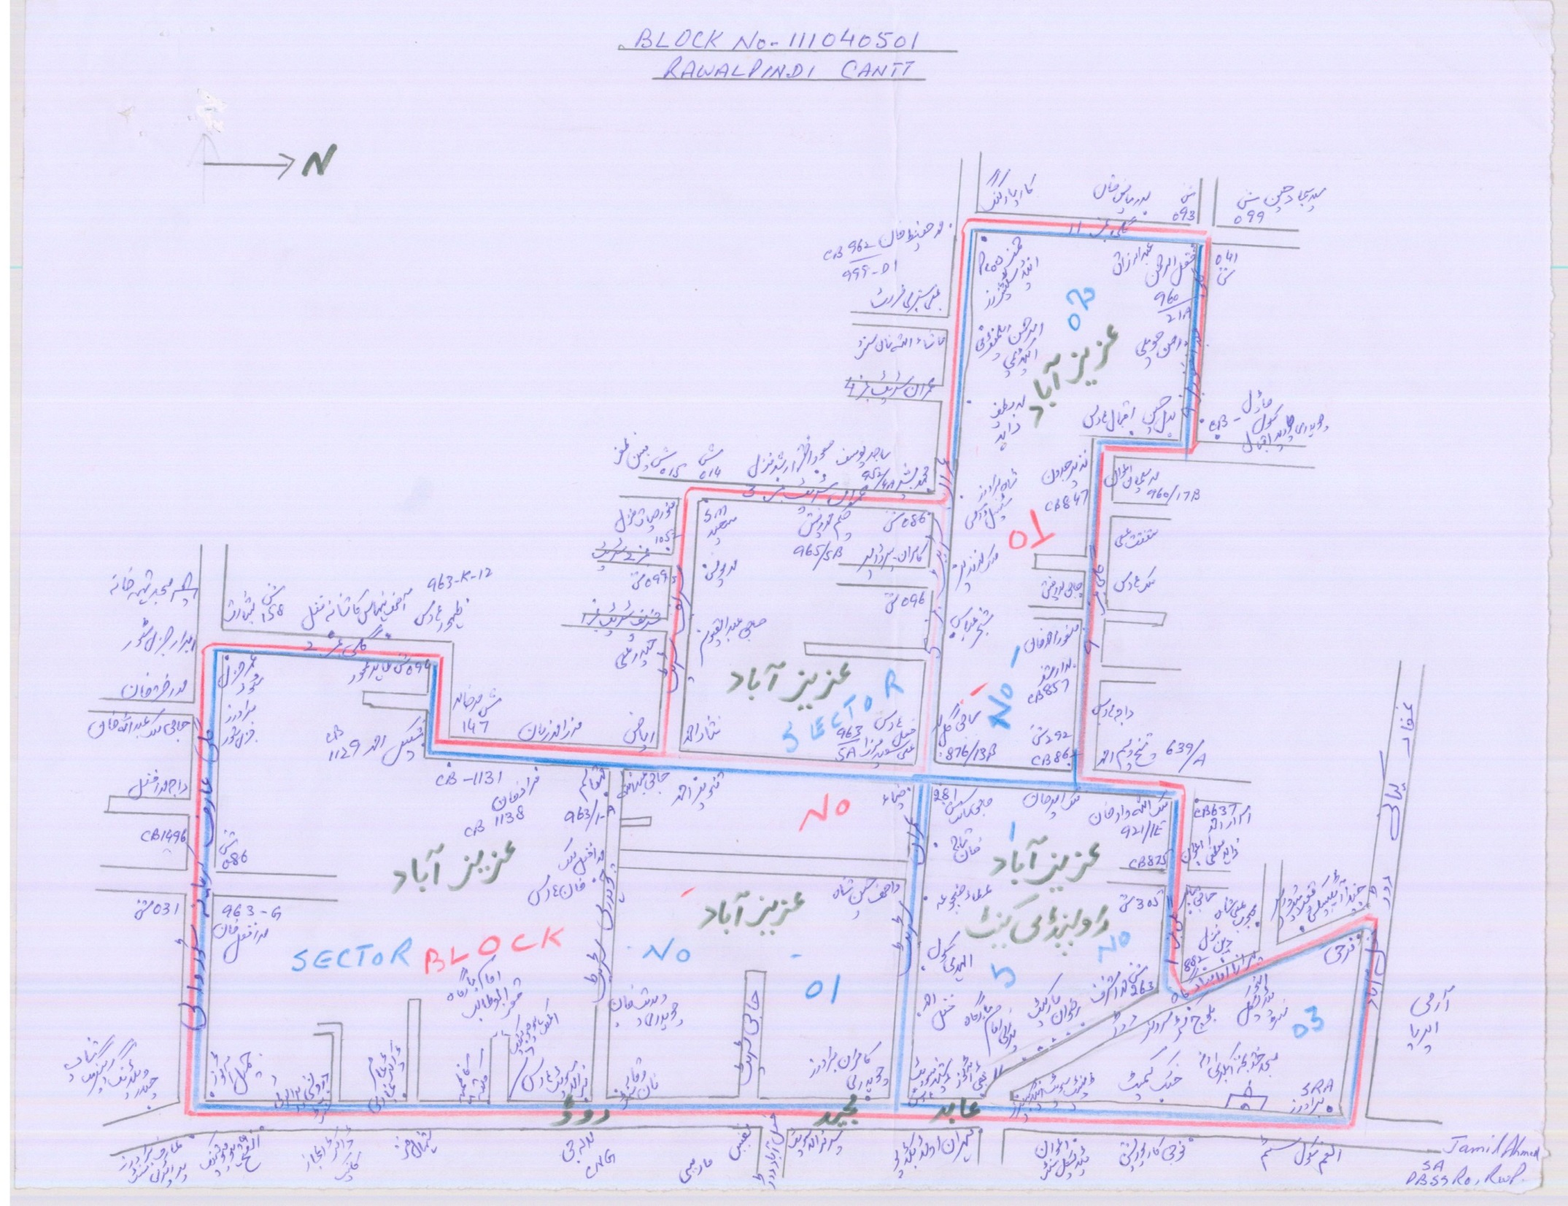

Slide 43
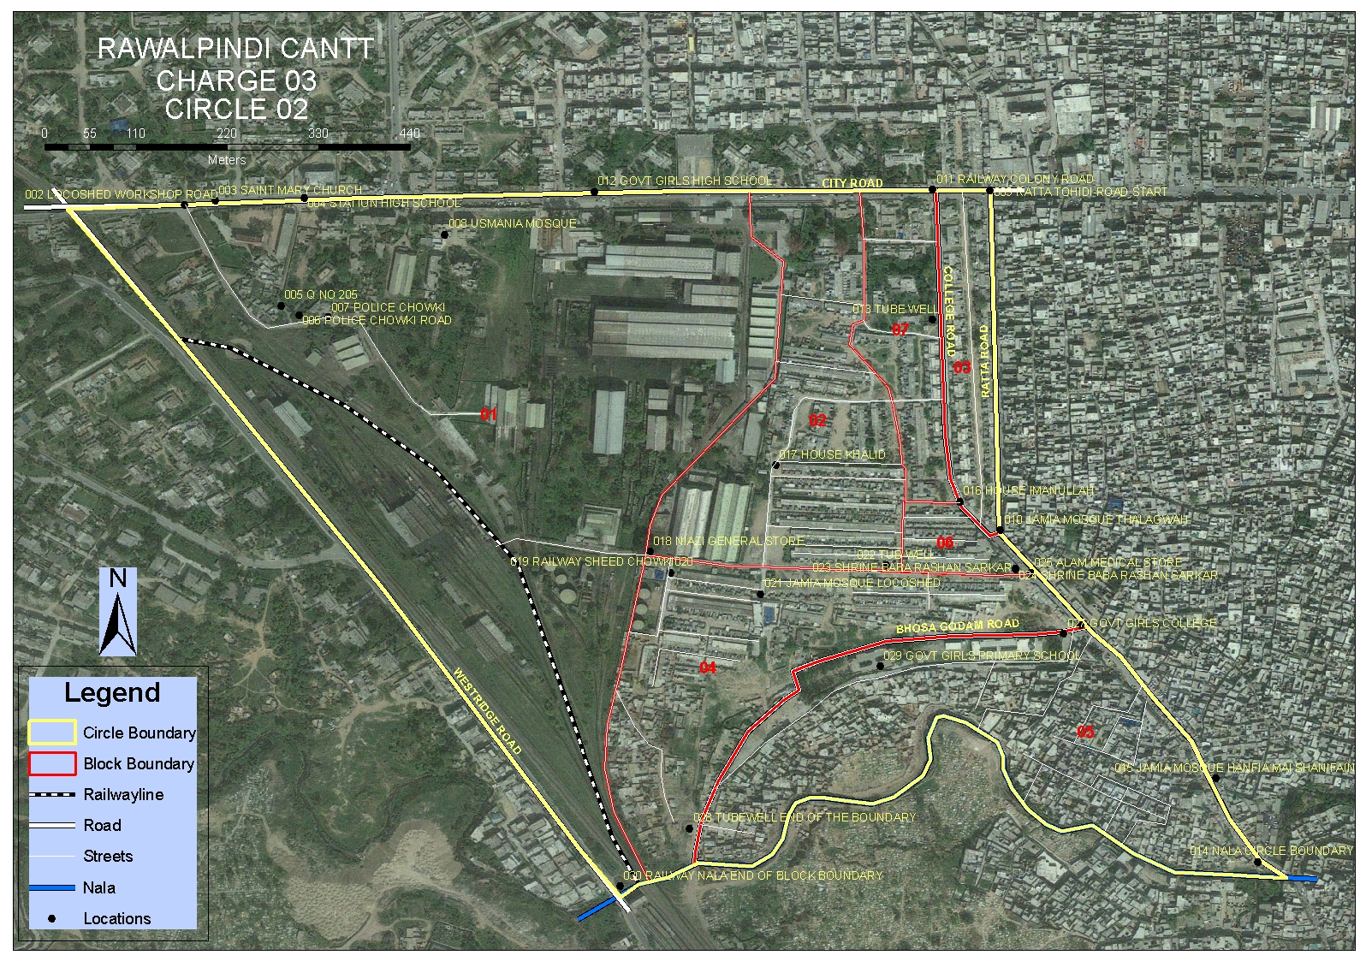

Slide 44
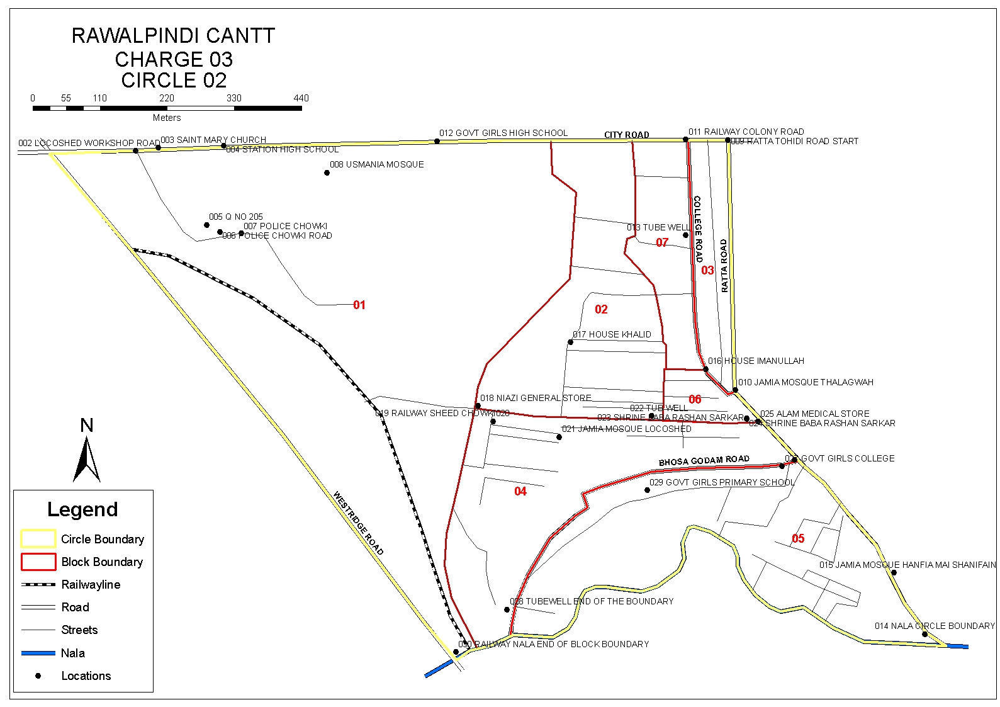

Slide 45
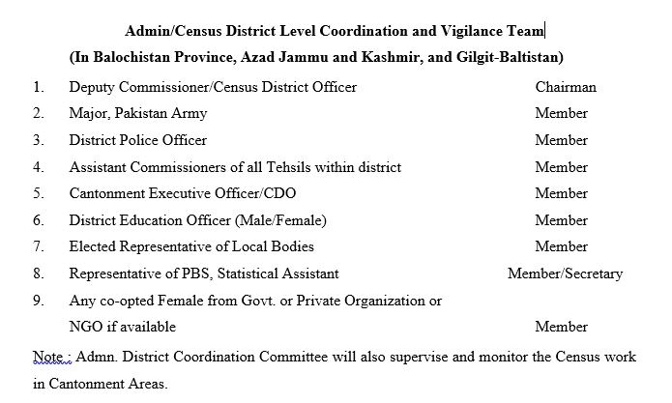

Slide 46
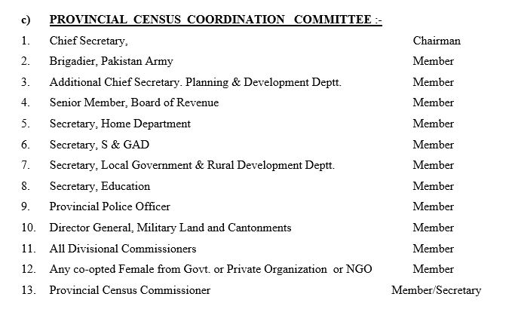

Slide 47
DECISION OF THE CABINET
“The Cabinet considered the summary titled “Approval of Results of the 6th Population and Housing Census-2017” dated 14th December, 2020 submitted by the Planning, Development & Special Initiatives Division, and approved the proposal contained in para 5 thereof.
Proposal at Para-5 of the Summary is as under :-
“Approval of the Cabinet is solicited to place the recommendations of the Ministers’ Committee, regarding approval of the final results of Census-2017, before the CCI for final approval”.
Notes:
47
47

Slide 48
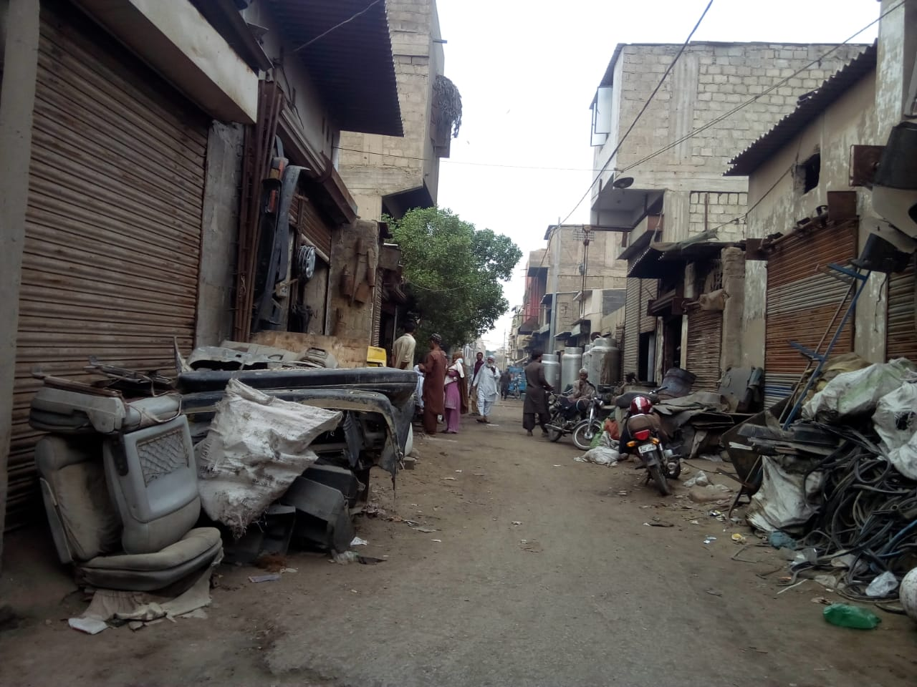

Slide 49
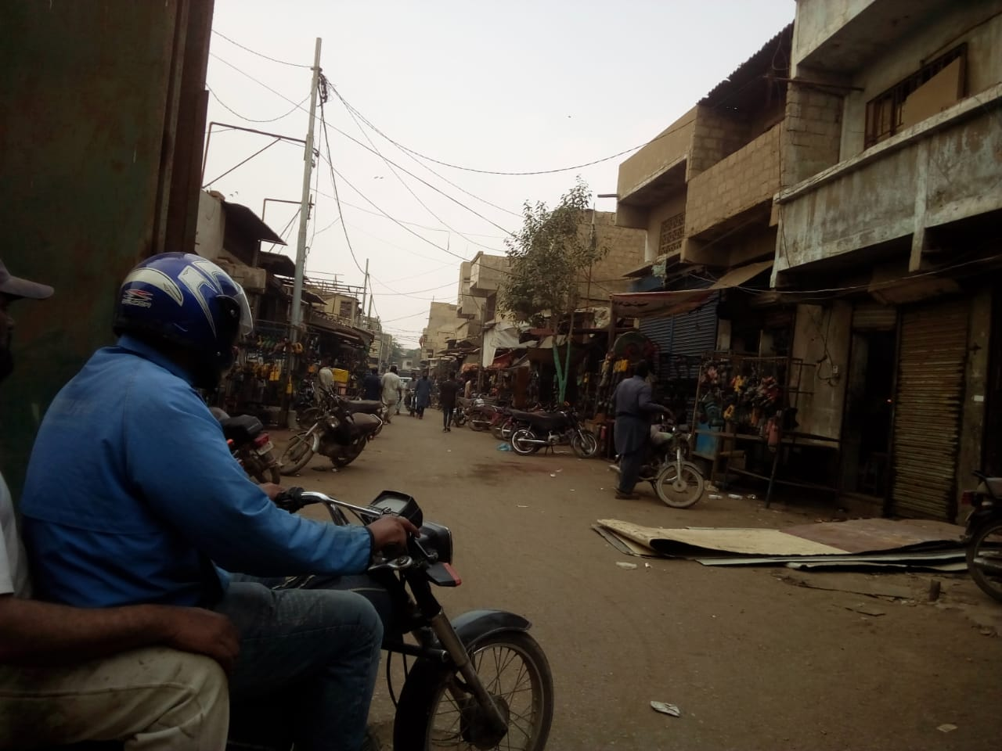

Slide 50
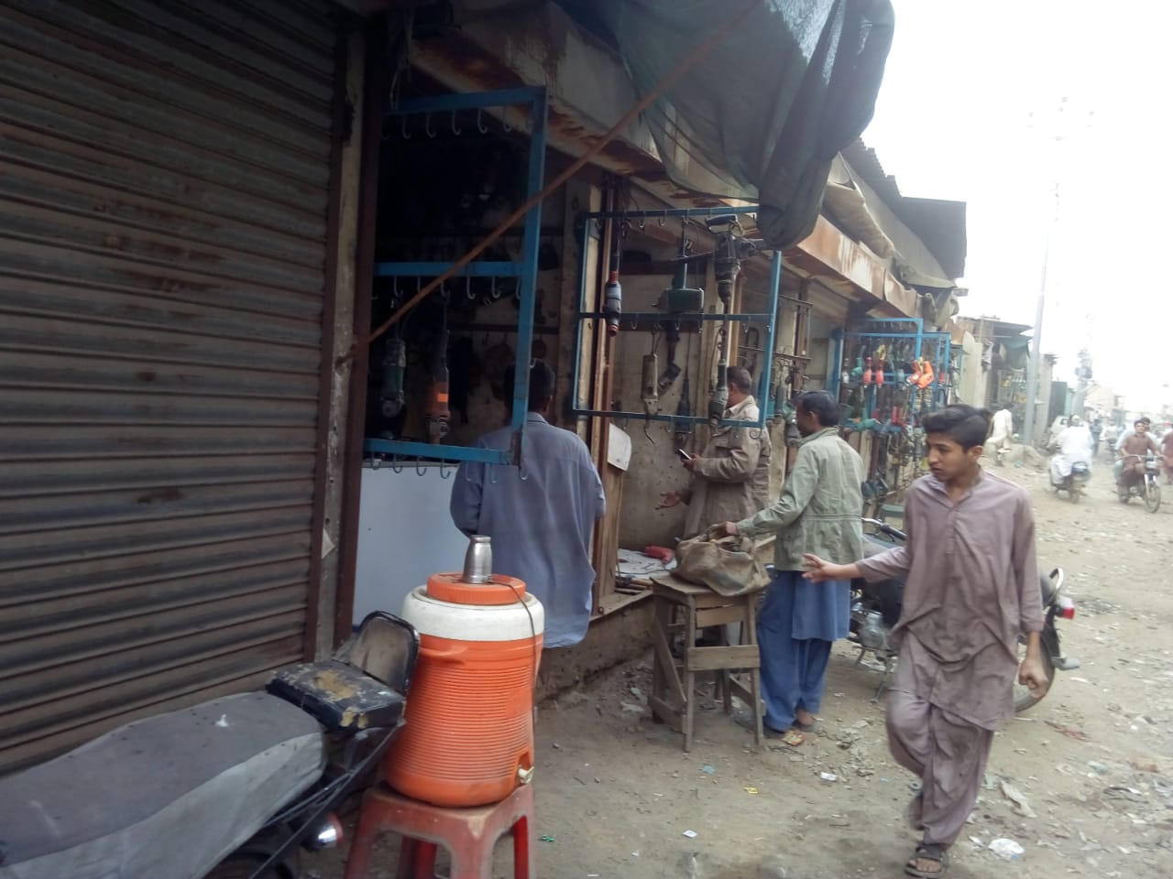

Slide 51
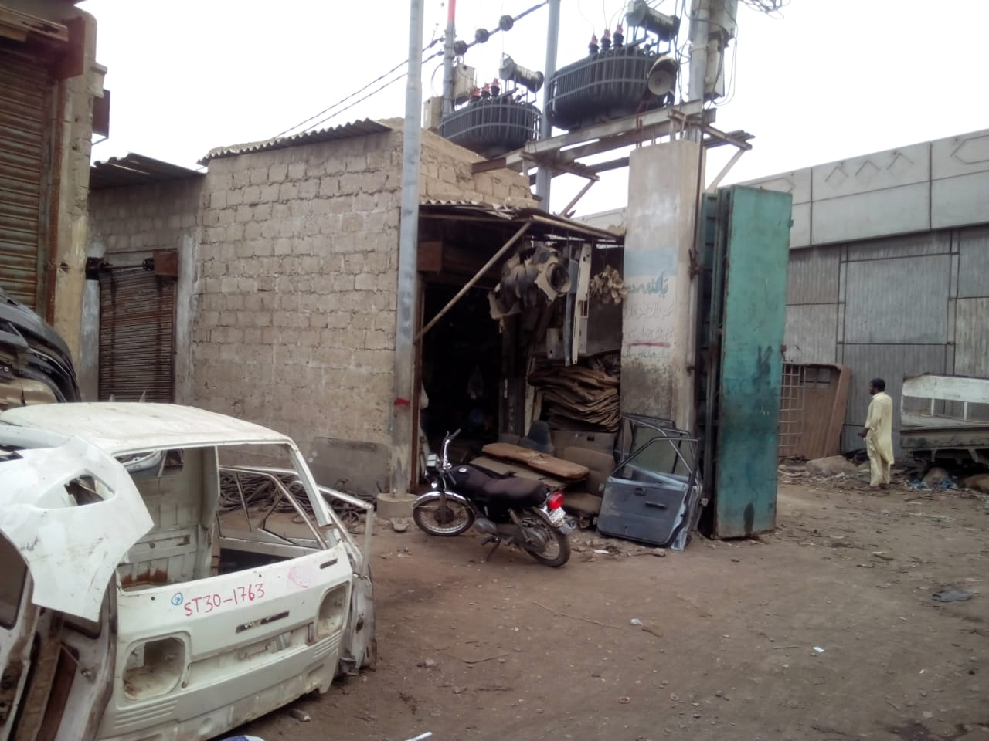

Slide 52
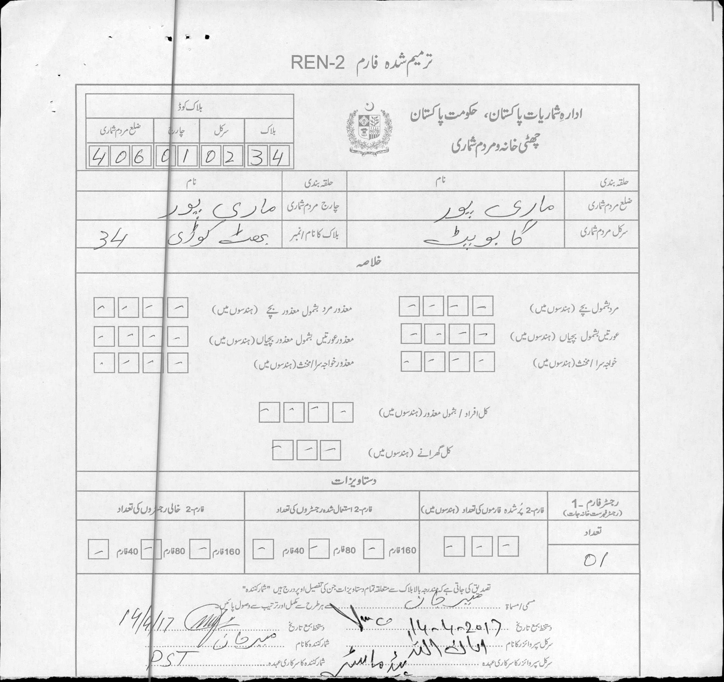

Slide 53
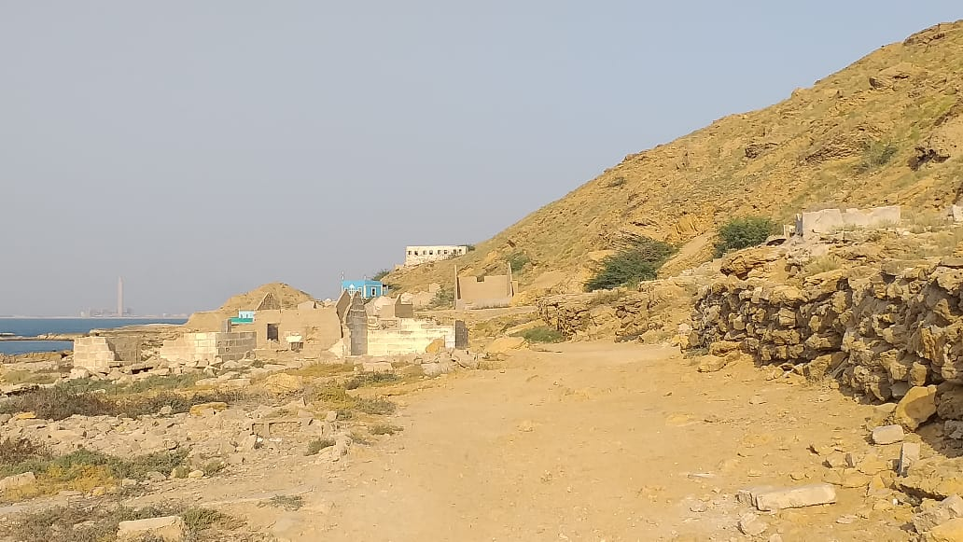

Slide 54
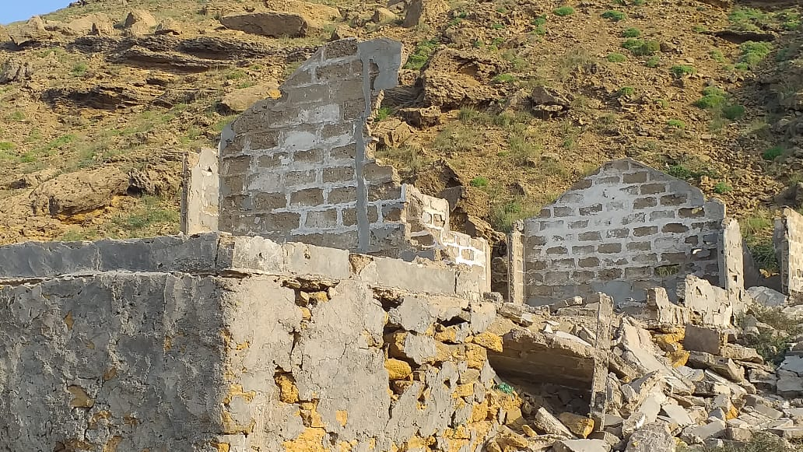

Slide 55
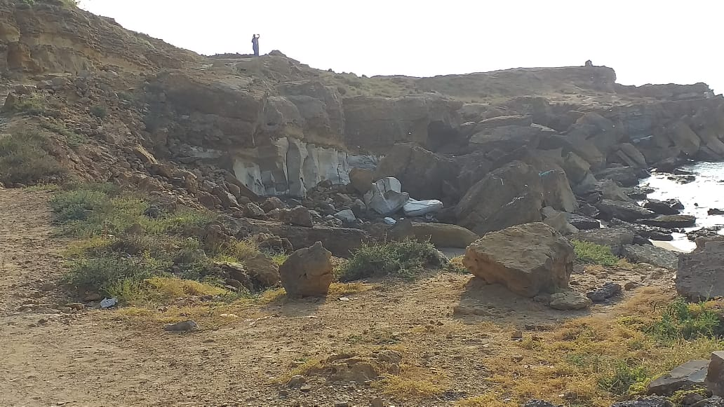

Slide 56
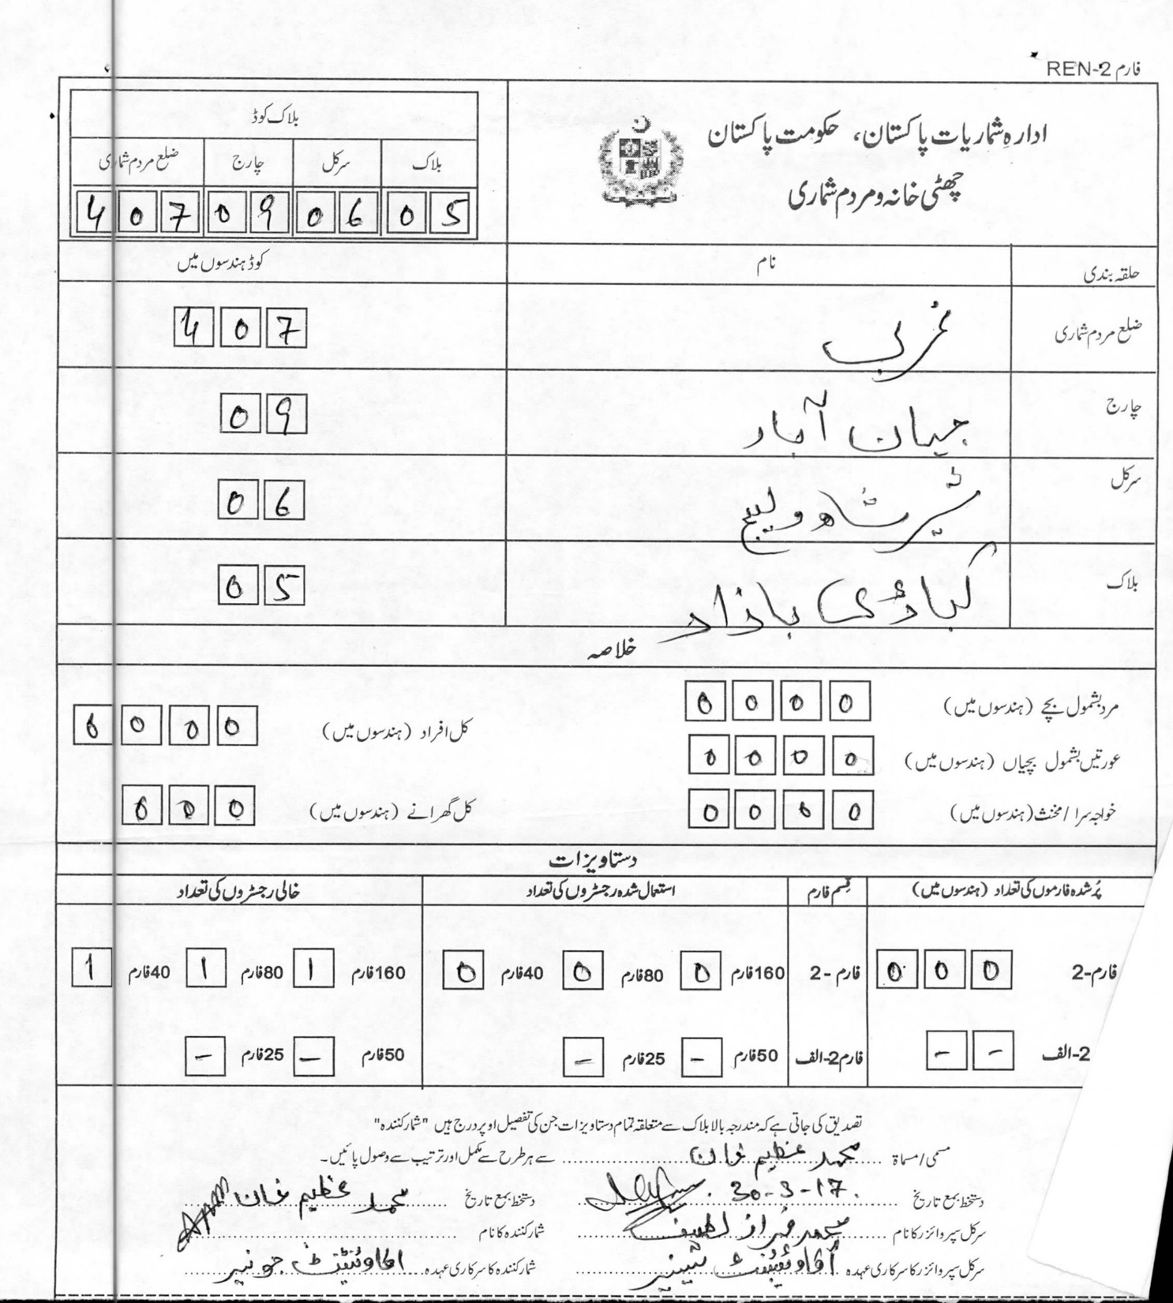

Slide 61
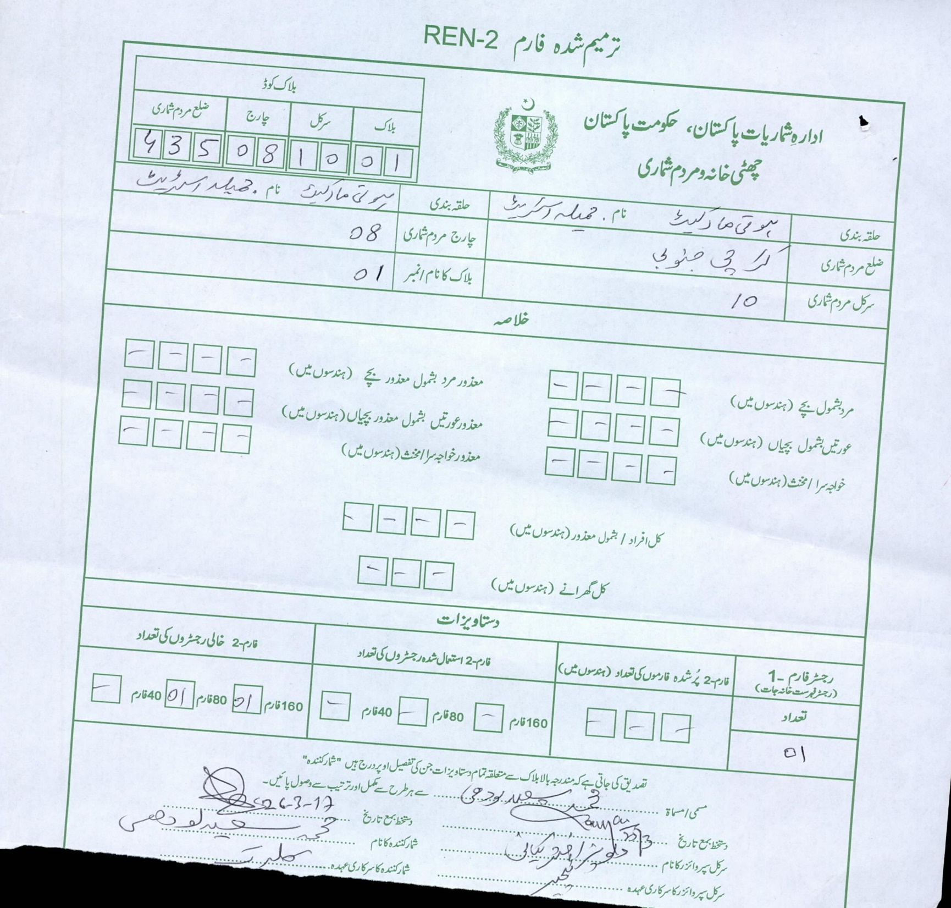

Slide 62
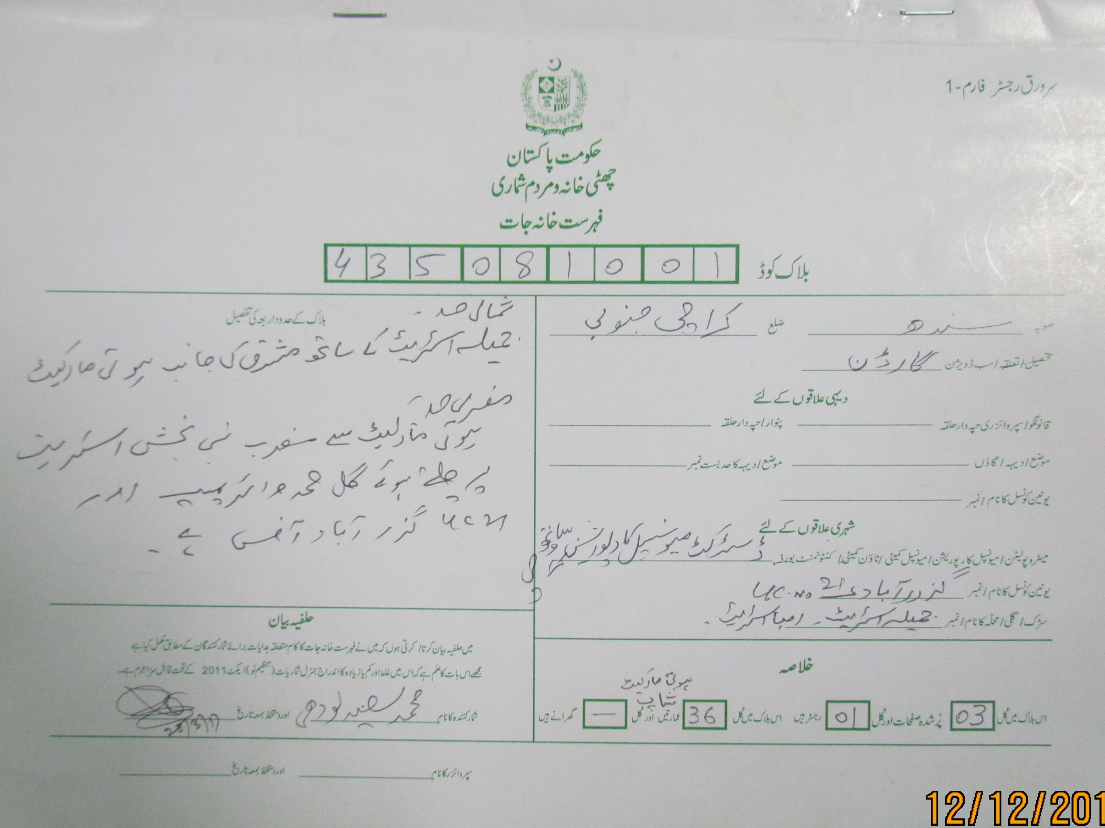

Slide 63
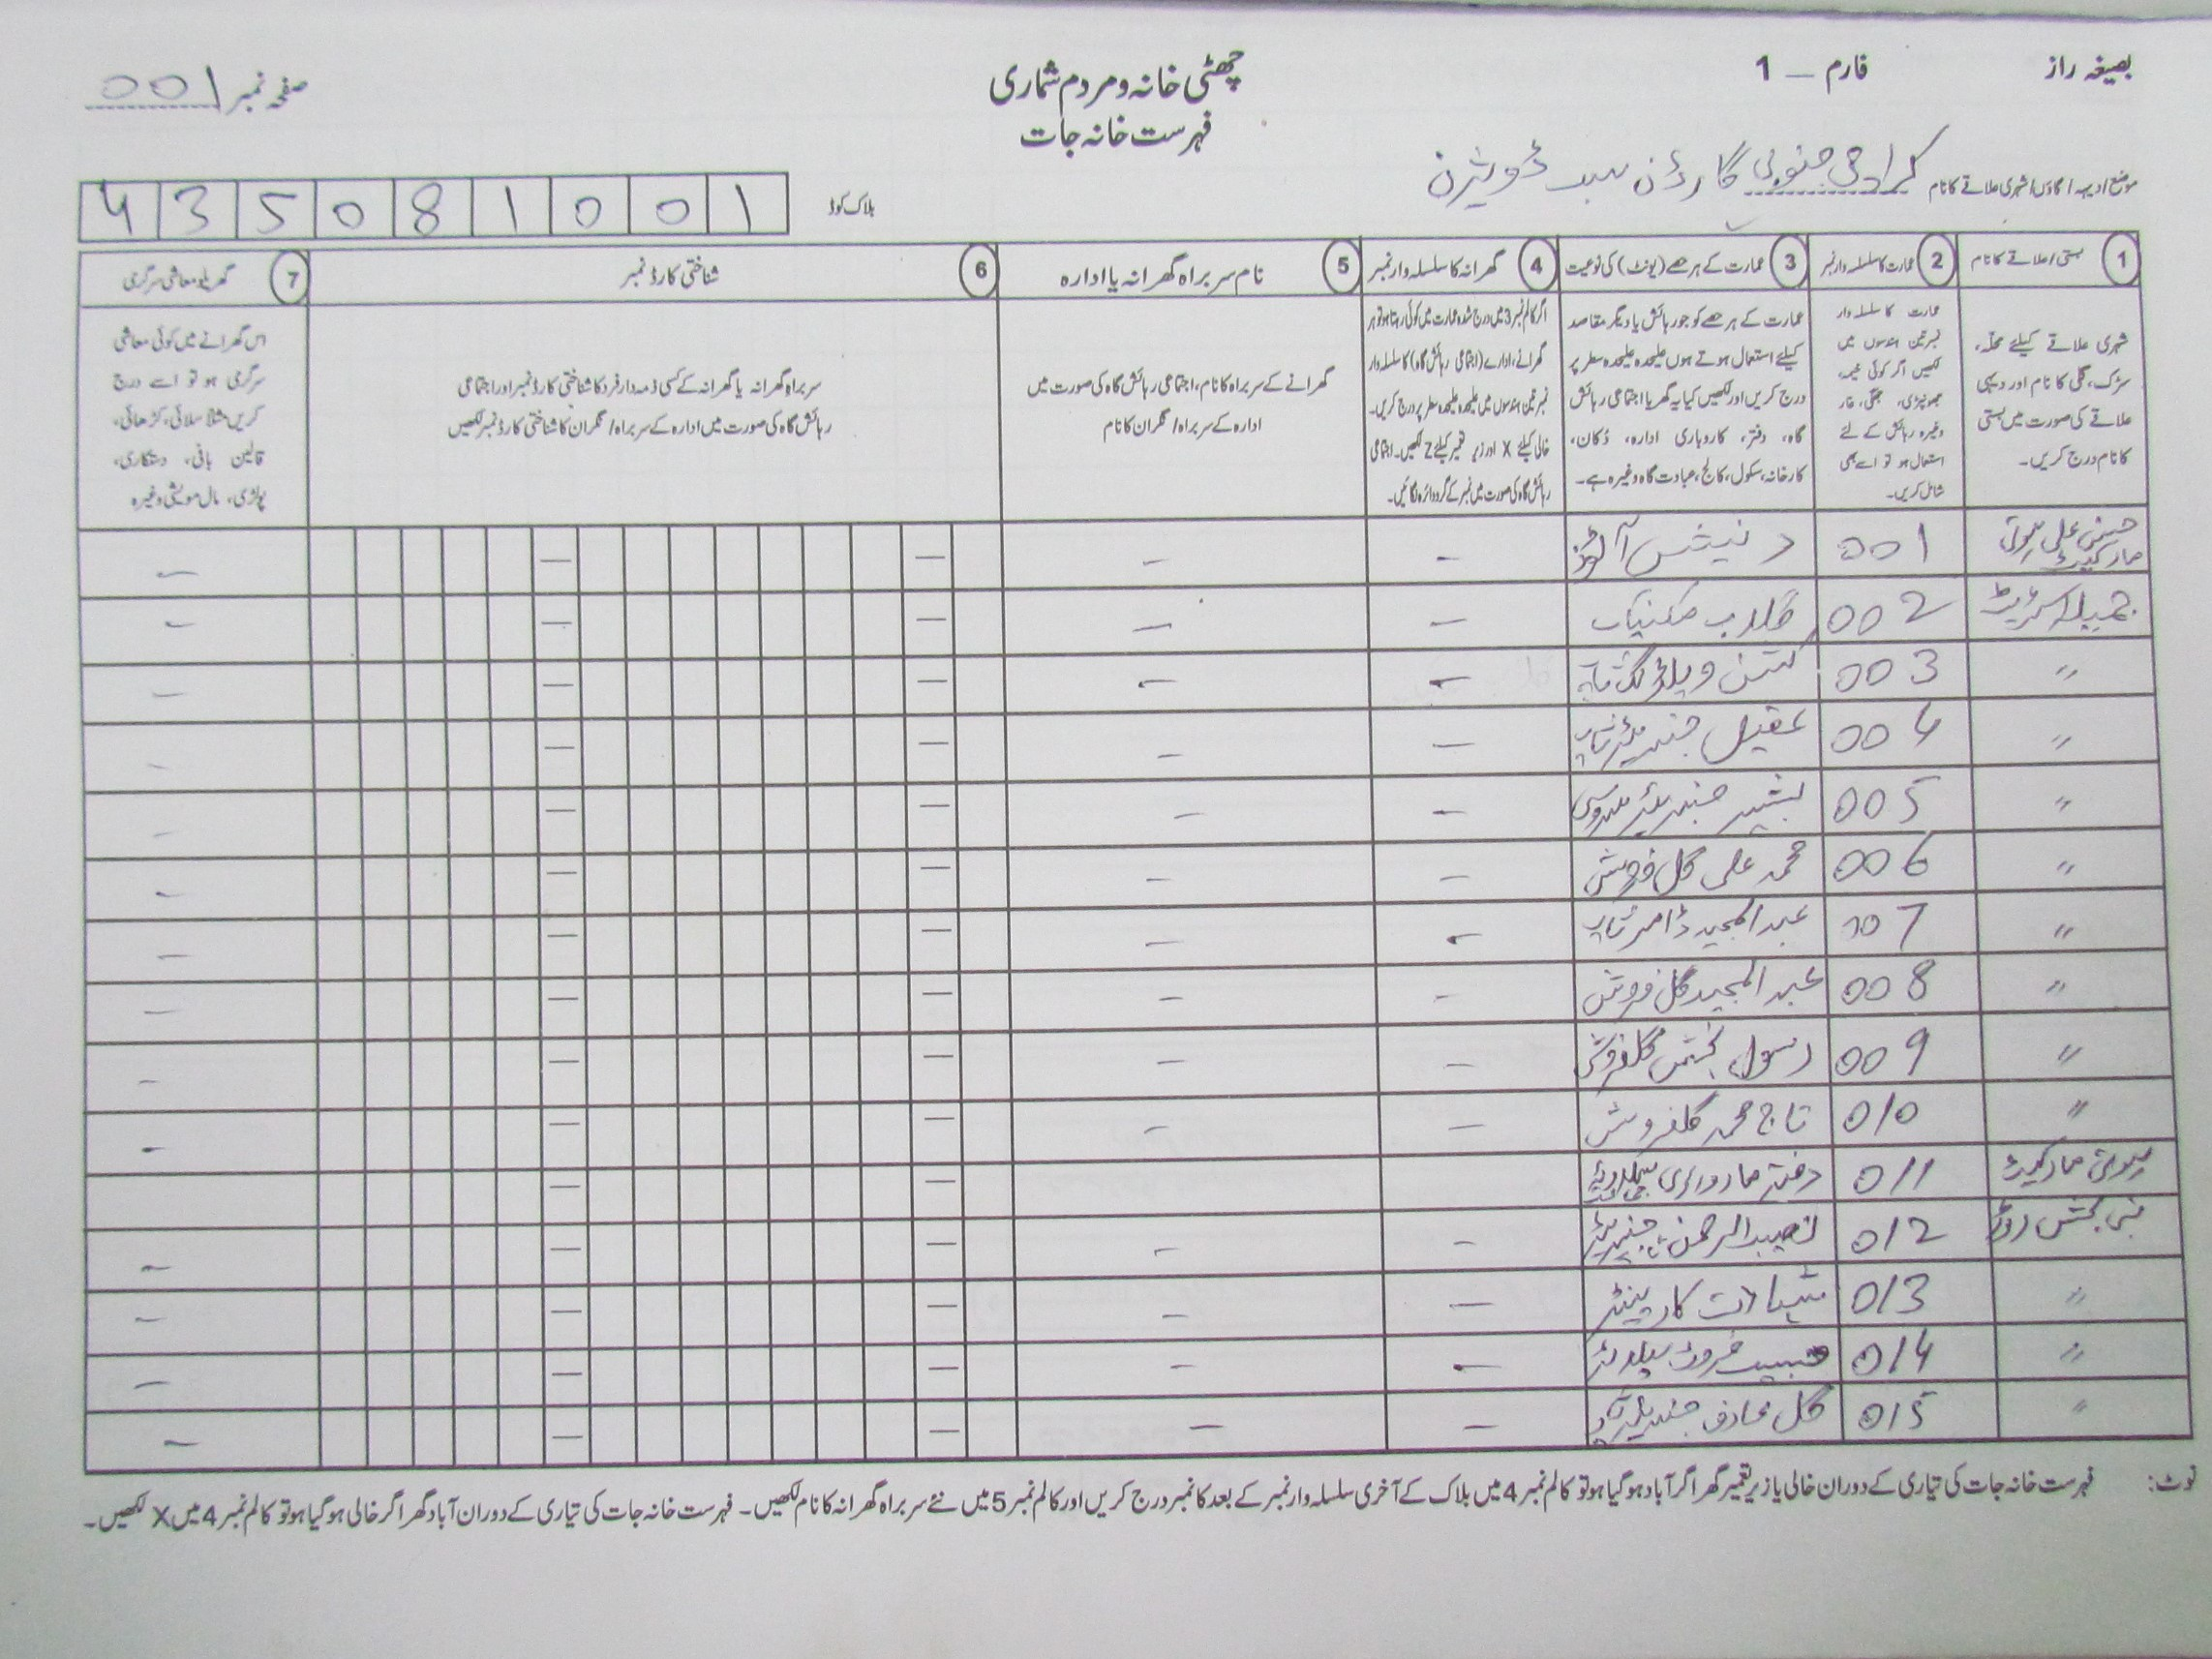

Slide 64
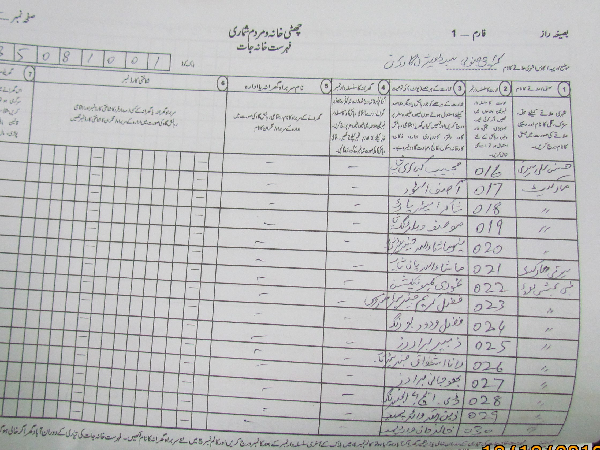

Slide 65
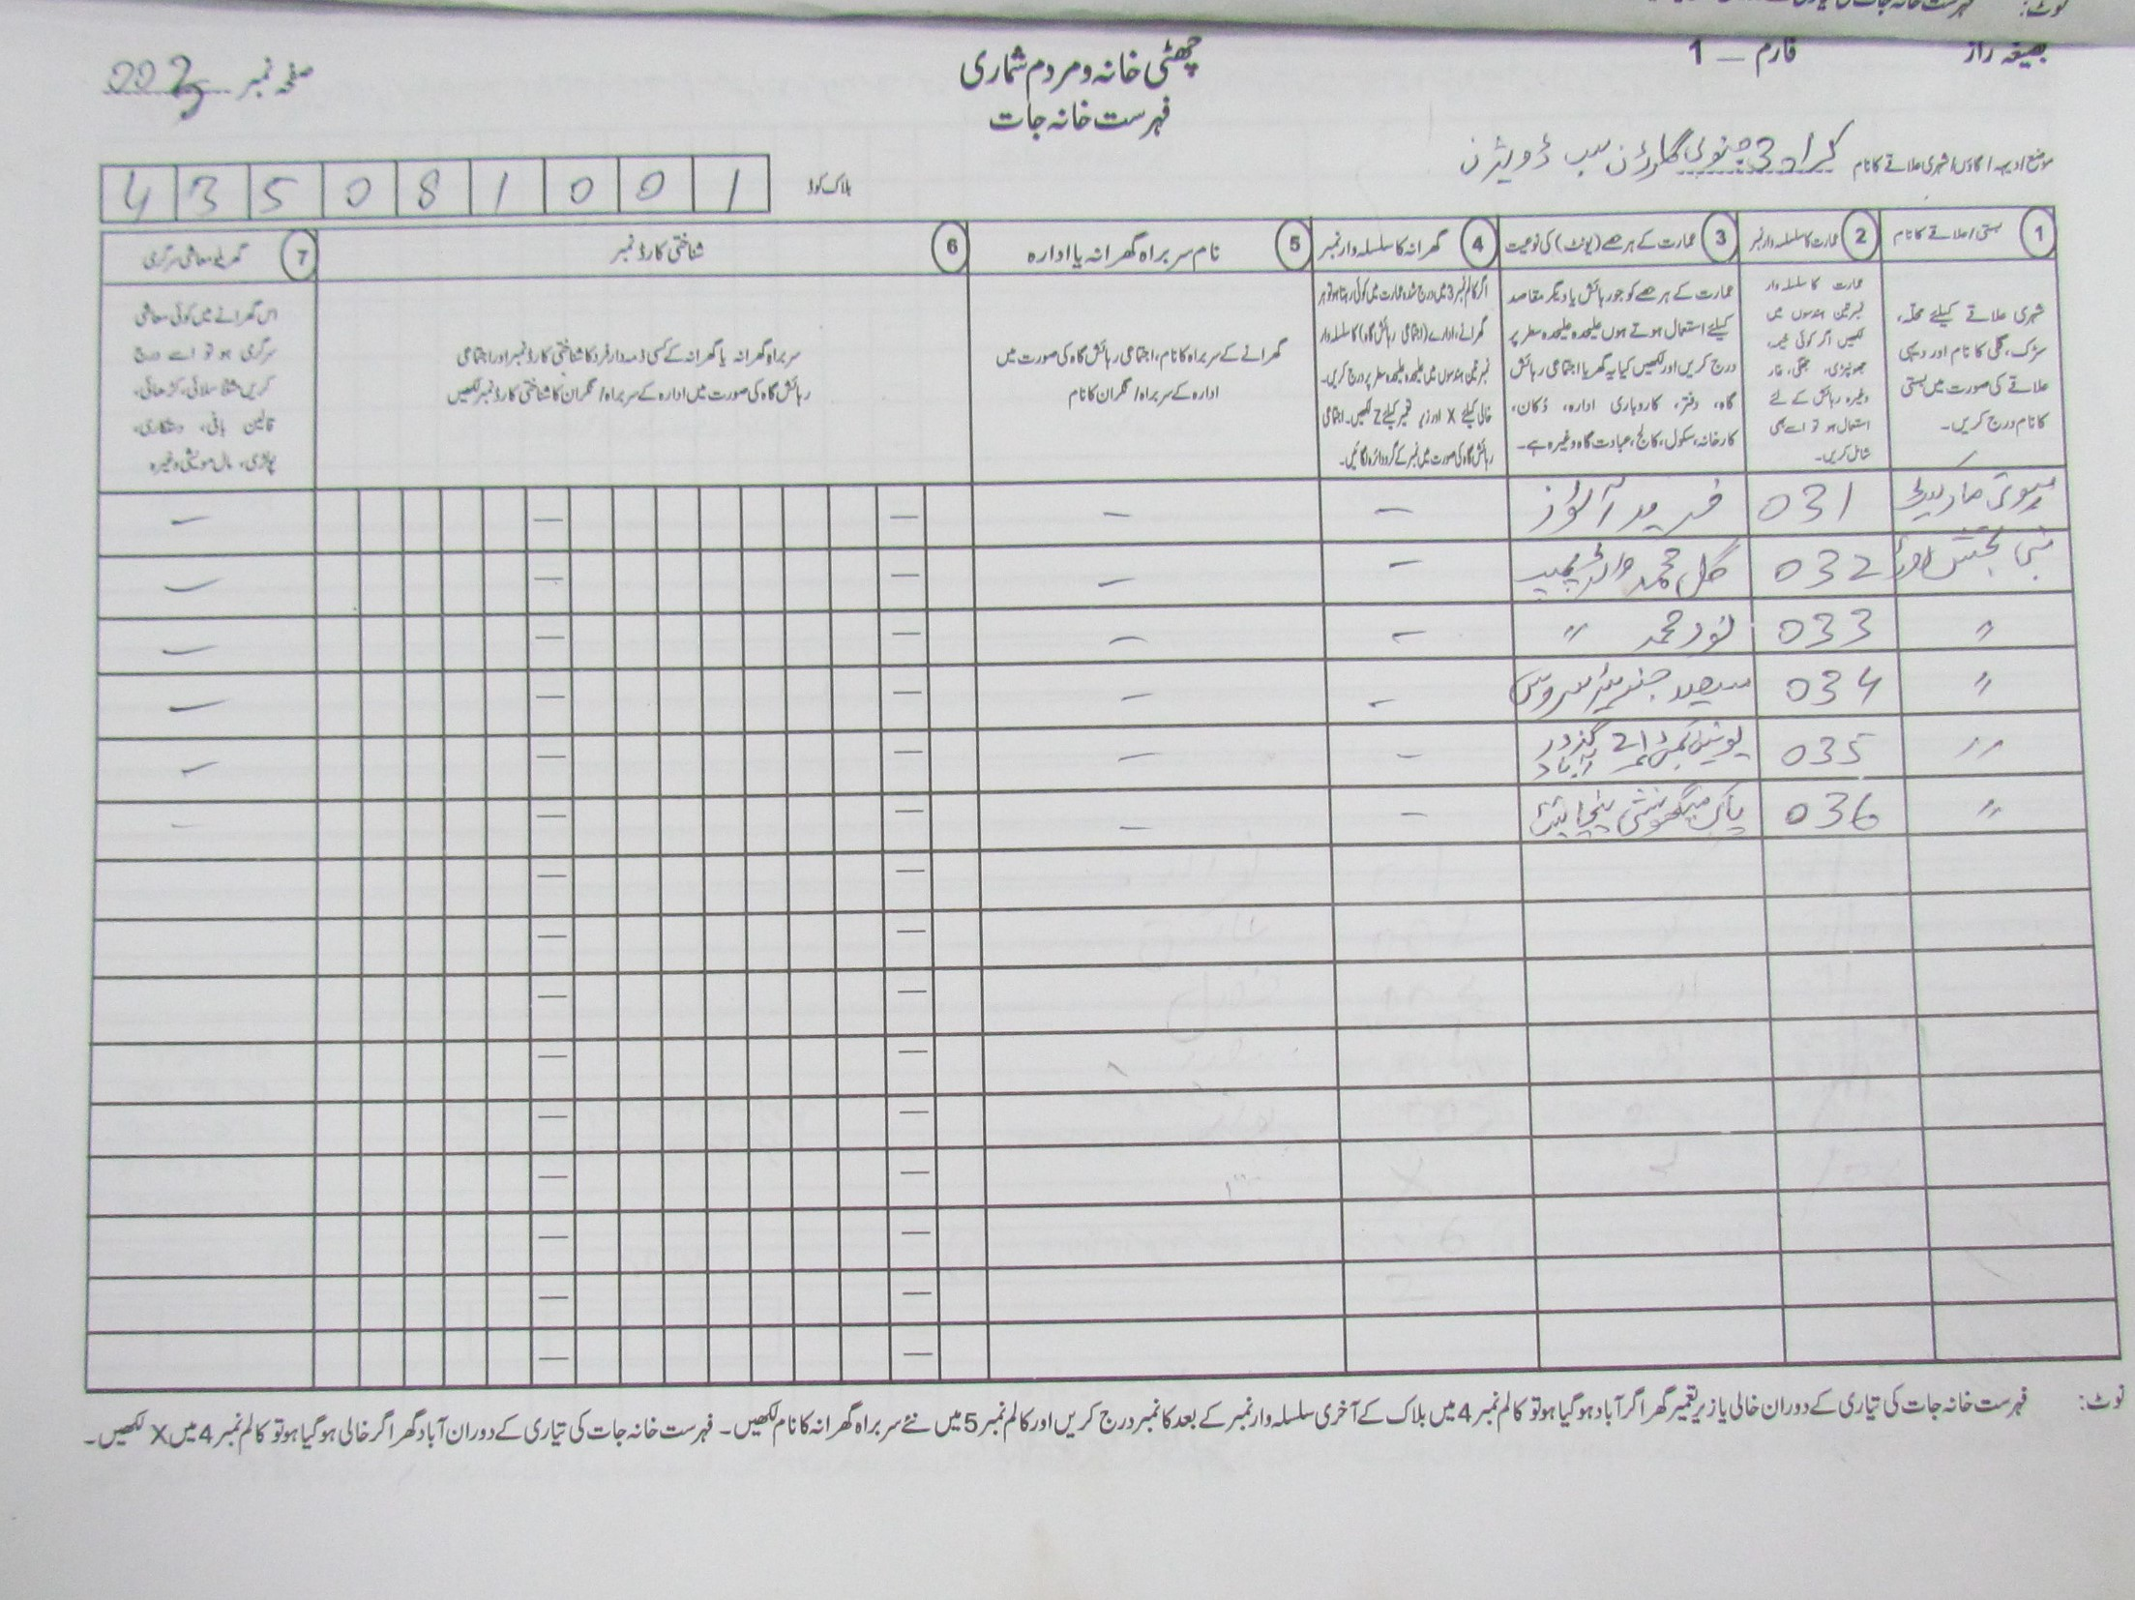

Slide 66
FACTS REGARDING 300 BLOCKS DATA PRESENTED BY MQM
List of 300 blocks selected by them was provided to PBS without any covering letter in Fifth Meeting of Cabinet Committee held on 9-10-2020.
  150 blocks were from Karachi Central District
  150 Blocks from Korangi District ( former Part of Karachi East District in 1998)
Wrong comparison done( single block of 1998 with single block of 2017), despite the fact the block of 1998 bifurcated in to many blocks before Census 2017
Incorrect Population numbers of 1998 in front of Blocks
Block codes old and new are almost same in both columns, however it is pertinent to mention that block code scheme is totally different in 1998

Slide 67
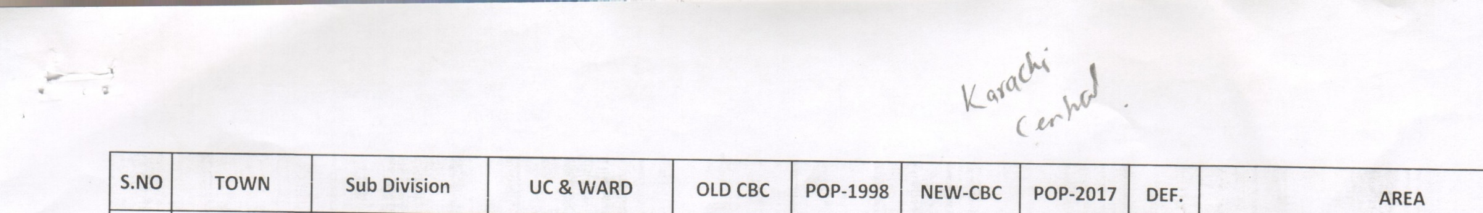
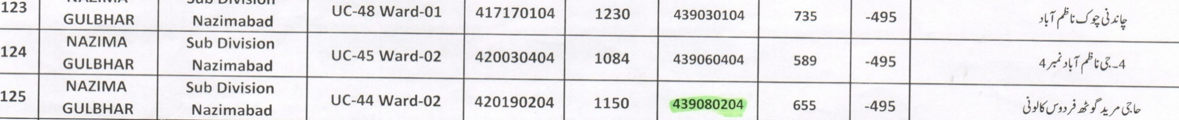
POPULATION VS BLOCKS ANOMALIES –KARACHI CENTRAL
S.no | Block code 1998 | Population 1998 | Remarks | Block codes in 2017 | Population 2017 | Remarks
125 | 121430204 | 1264 | This block was bifurcated in to four blocks before census 2017 | 439080201 439080203 439080204 439080205 | 914 2581 655 1176
Population 1998:1264
Population 2017:5326
Percentage Increase: 321%
Growth Rate: 7.85
Notes:
67
67

Slide 68
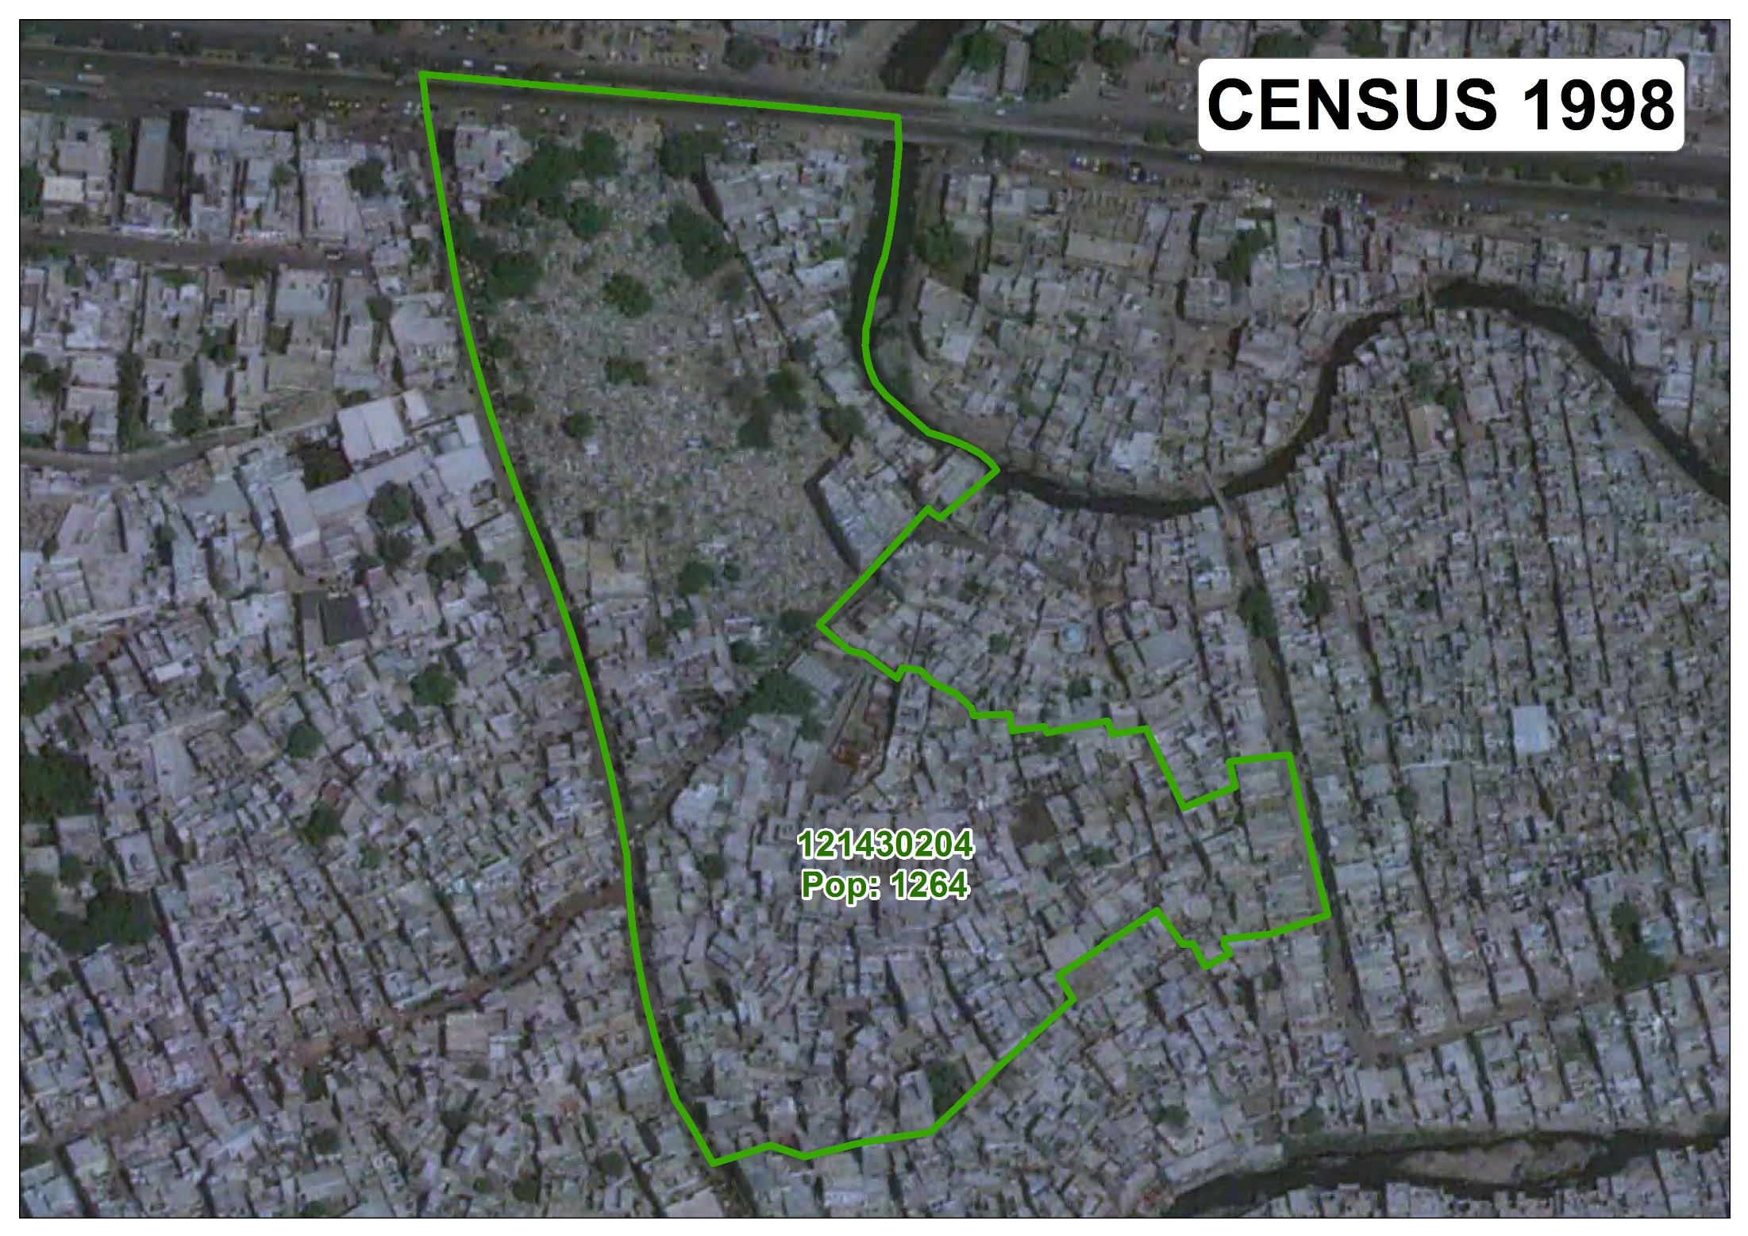

Slide 69
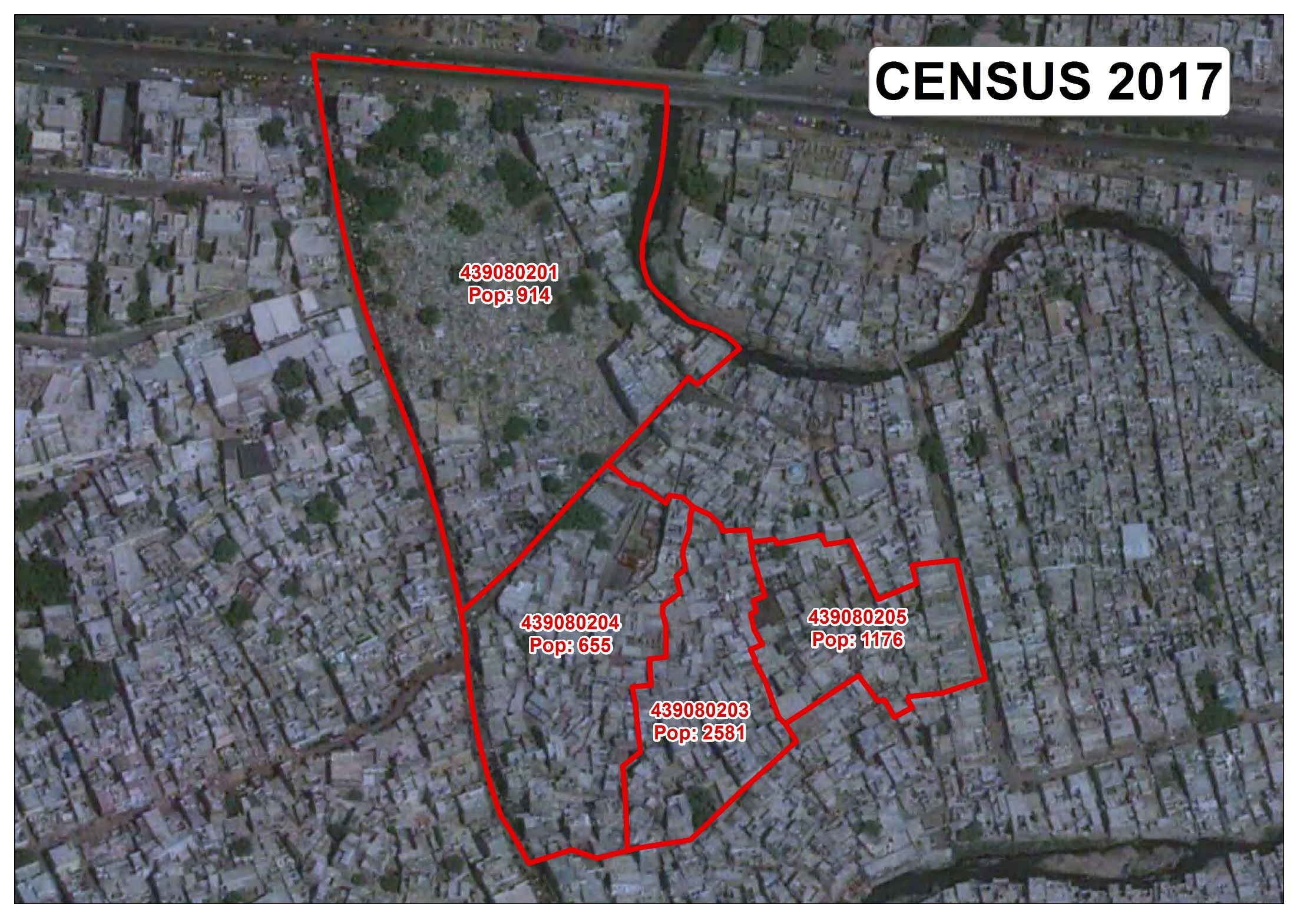

Slide 70
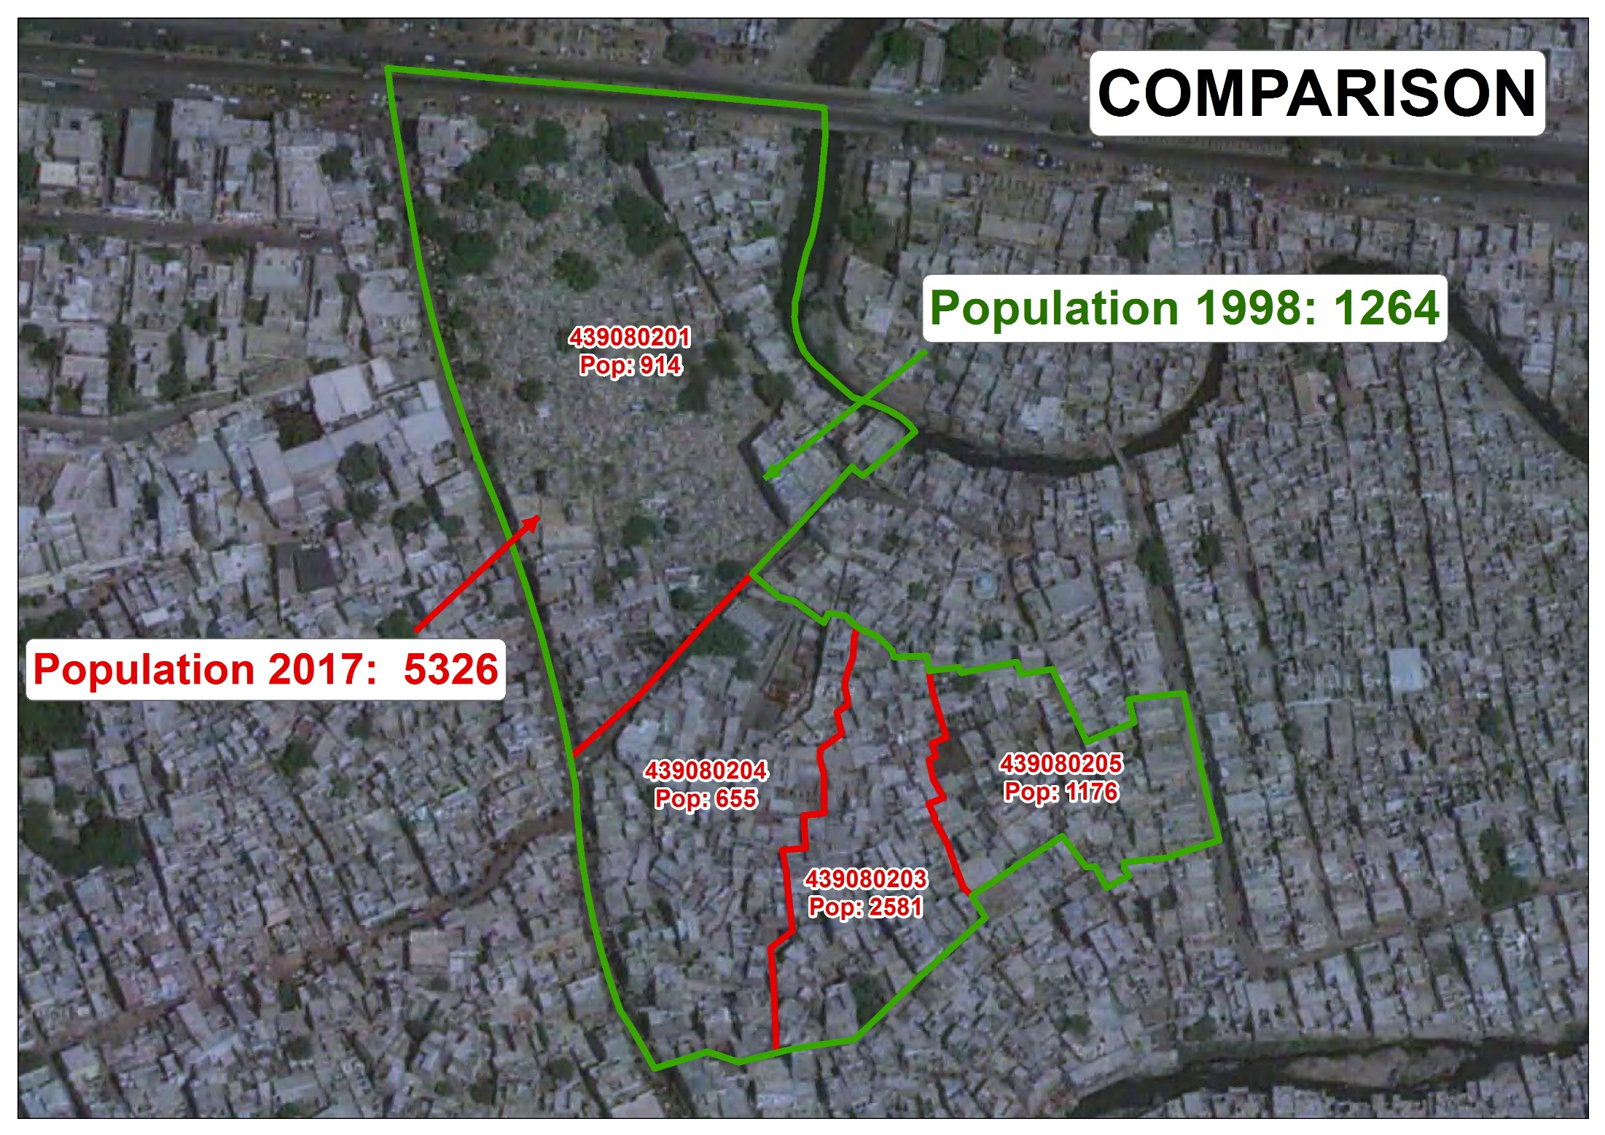

Slide 71
POPULATION VS BLOCKS ANOMALIES –KARACHI CENTRAL
S.No | Block code 1998 | Population 1998 | Remarks | Block codes in 2017 | Population 2017 | Remarks
50 | 121450501 | 1197 | This block was bifurcated in to four blocks before census 2017, two blocks in same circle and two added in another circle | 417050804 417050805 417050101 417050102 | 1252 217 819 1174
Population 1998:1197
Population 2017:3462
Percentage Increase: 189%
Growth Rate: 5.74
Notes:
71
71

Slide 72
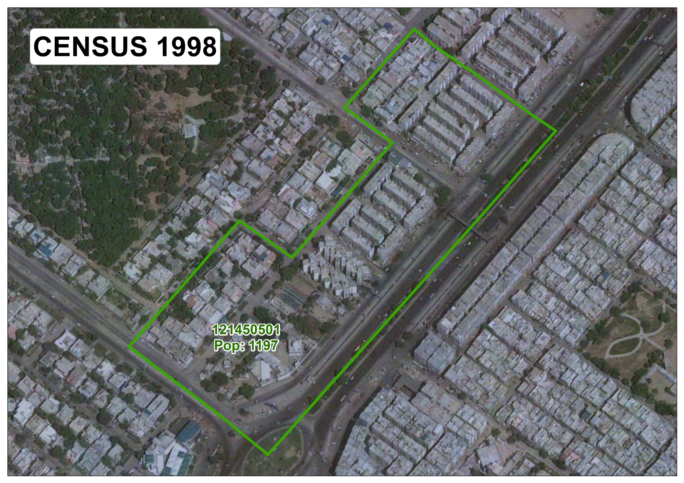

Slide 73
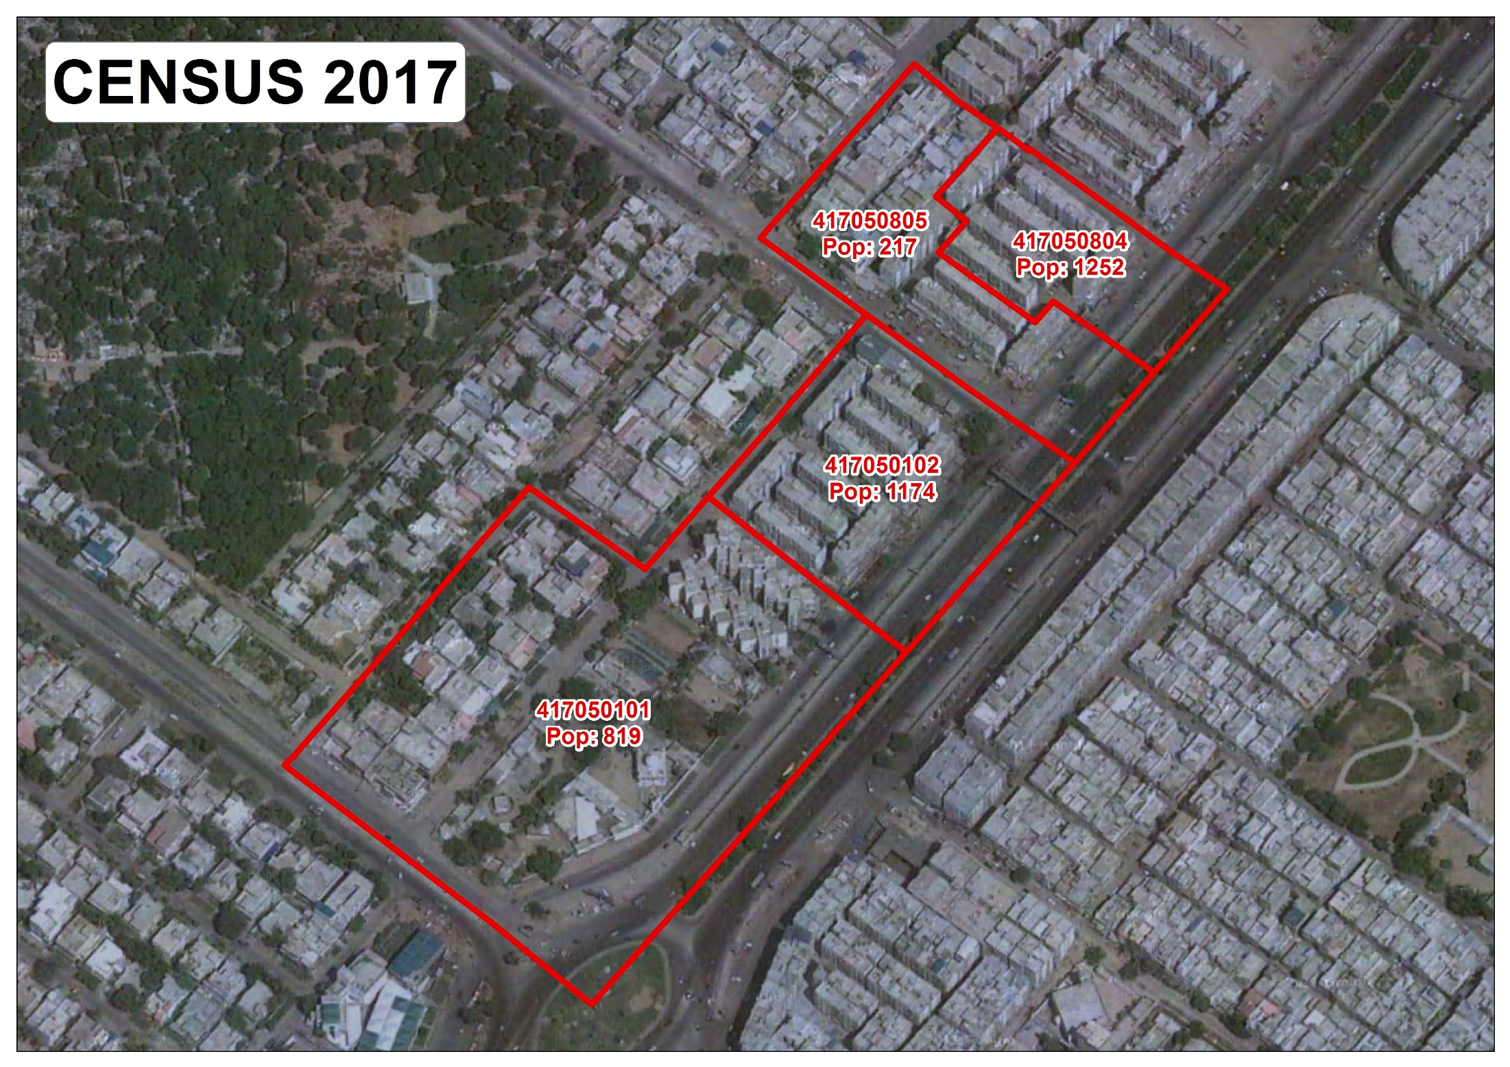

Slide 74
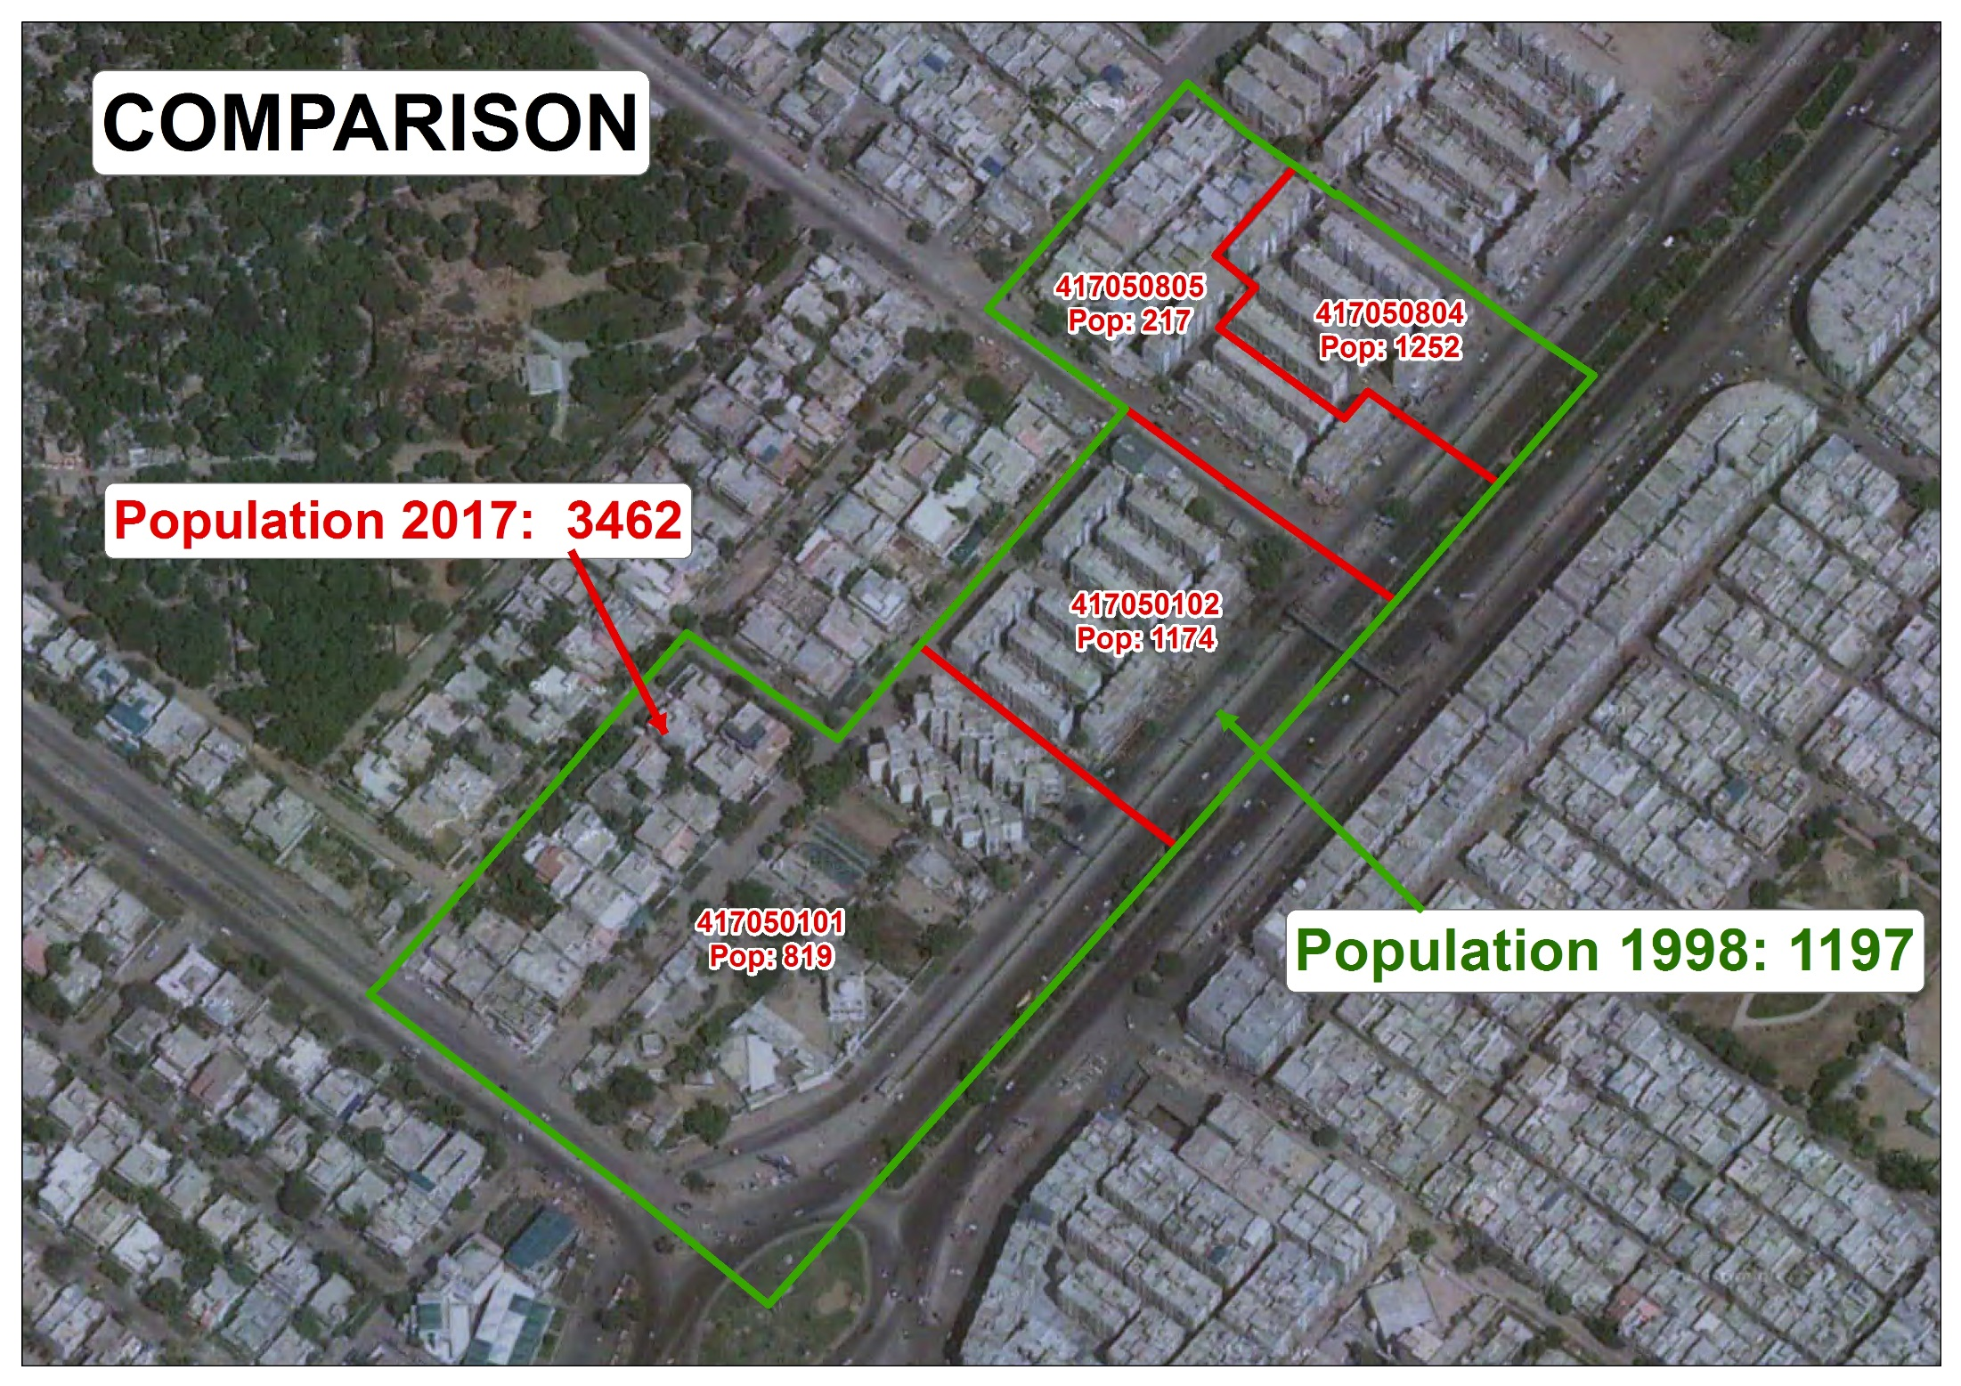

Slide 75
POPULATION CENSUS DATA AS COMPARED TO NADRA DATA
According to official Data received From NADRA up to May 2018:-
Adult population registered in NADRA with permanent address and total CNIC issued in Karachi is less than Population of Census 2017
Area | Population All Ages Census -2017 | Population registered with NADRA
 |  | Population 18+ | % | Total CNIC Issued | % CNIC of Pop.
1 | 2 | 3 | 4 | 5 | 6
KARACHI DIVISION | 16,051,521 | 9,649,732 | 60.22 | 9,219,850 | 57
LAHORE | 11,126,285 | 6,677,924 | 60.05 | 5,990,000 | 54

Slide 77
DECISION OF THE CABINET
“The Cabinet considered the summary titled “Approval of Results of the 6th Population and Housing Census-2017” dated 14th December, 2020 submitted by the Planning, Development & Special Initiatives Division, and approved the proposal contained in para 5 thereof.
Proposal at Para-5 of the Summary is as under :-
“Approval of the Cabinet is solicited to place the recommendations of the Ministers’ Committee, regarding approval of the final results of Census-2017, before the CCI for final approval”.
Notes:
77
77

Slide 78
THANK YOU

